Slide 1
Governments of the World

Slide 2
Types of Governments
Direct Democracy |  |  | Representative Democracy
Monarchy |  |  | Constitutional Monarchy
Aristocracy | Theocracy | Oligarchy | Dictatorship | Anarchy
Notes:
What are the differences between these?
What was Ancient Greece? Democracy: Gov by the people- voting
Rome? Rep Dem = Republic- rule by representatives of the people (Rome/US)
What are we? Monarchy: rule by single leader- Divine Right- life time- inherited
What is England? Constitutional Monarchy- Parliamentary England
All these are forms of autocracy Aristocracy: rule by the wealthy
Theocracy: rule by religion- priest as leader- Vatican City, Ancient Egypt,
Modern Iran
Oligarchy: rule by a few
Dictatorship: rule by one, total control of life
Anarchy: total lack of gov. No rules or leaders

Slide 3
Decision Making
Autocratic or Democratic?
Teacher decides there will be a test on Friday
Group of friends decide on what movie to see by vote
Fast food manager gives workers a dollar raise
Parents listen to daughter complain about curfew and
decide to let her stay out an hour later.
Parents allow all the kids to vote on where to vacation
Major, elected by citizens, decides to guild a new city
hall
Citizens vote in favor of a city tax to fund schools

Slide 4
Practice: forms of government
http://www.brainrush.com/lesson/play/types-of-government

Slide 5
What do we value in the US?
Democracy
natural rights
equality
religious and other freedoms
How did we get there?
Notes:
What kind of a democracy are we?
What is another name for that?
How did we get to this? History of democracy.

Slide 6
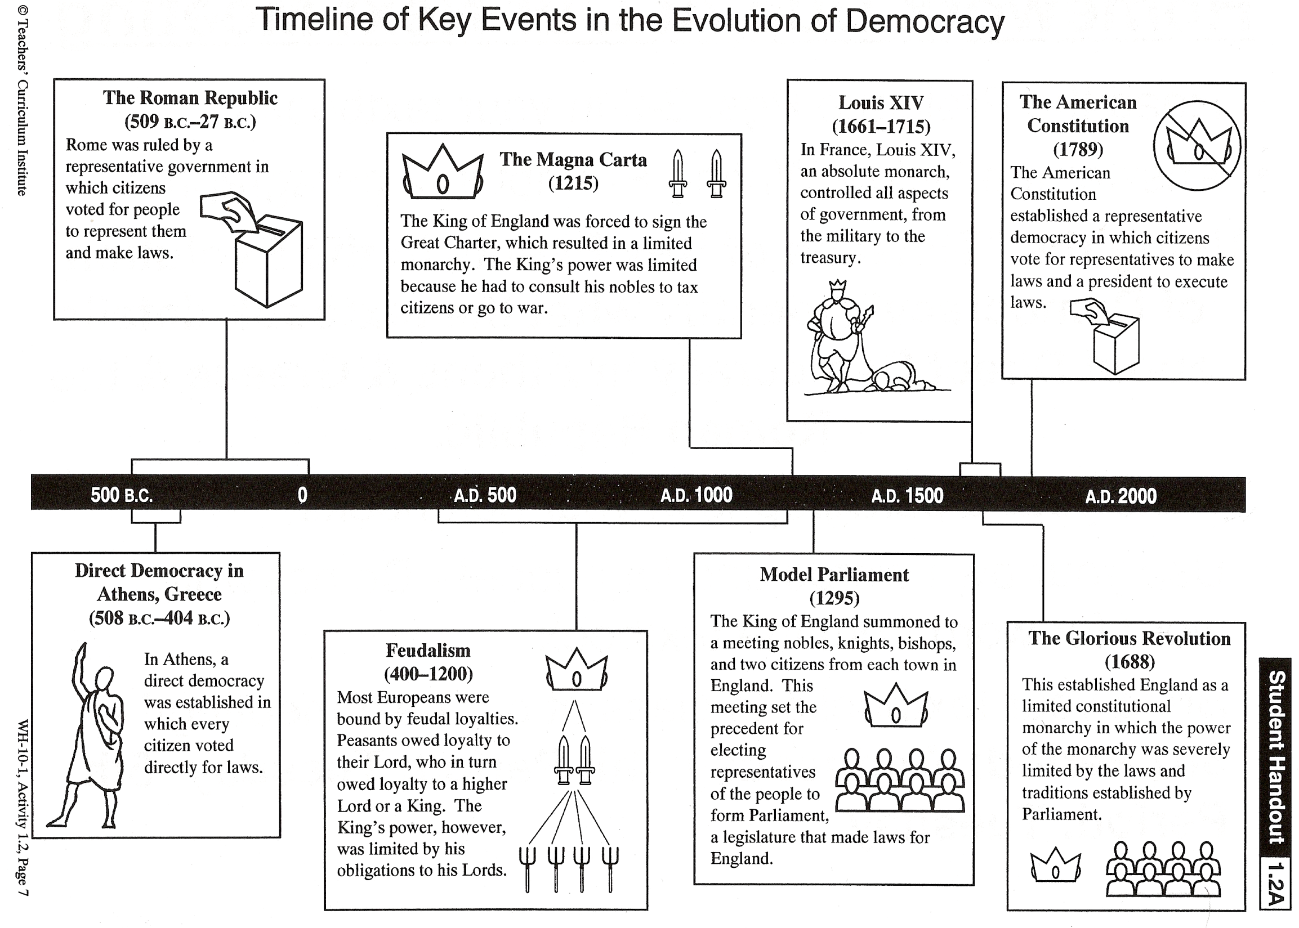

Slide 7
How did this happen?
The value of thinkers
Key philosophers touched the world and brought about new ways of doing things.
      Hobbes
      Locke
      Voltaire
      Rousseau
      Montesquieu
Notes:
Each had a key role in changes. We will see their influence throughout the year, so these should be memorized.
Hobbes
Thinking had started with idea of natural and observable laws in Greece and the sense of community and human value in religion. During the Enlightenment, thinkers extended these ideas greatly.
Locke
Voltaire
Rousseau
Montesquieu

Slide 8
Practice: Enlightenment thinkers
https://www.superteachertools.net/speedmatch/speedmatch.php?gamefile=1414983909

Slide 9
History of Democracy
http://www.history.com/shows/mankind-the-story-of-all-of-us/videos/mankind-the-story-of-all-of-us-birth-of-democracy

