Slide 1
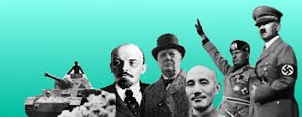
Years of Crisis, 1919-1939

Slide 2
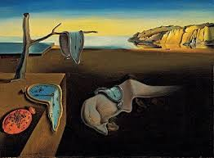
People React to Uncertainties
Freud: believed people are irrational
Driven by unconscious drives
Thinkers: existentialist philosophy
no universal meaning to life
each person creates their own meaning in life
Art: surrealism
_{Beyond or above reality}
_{Dreamlike quality}

Slide 3
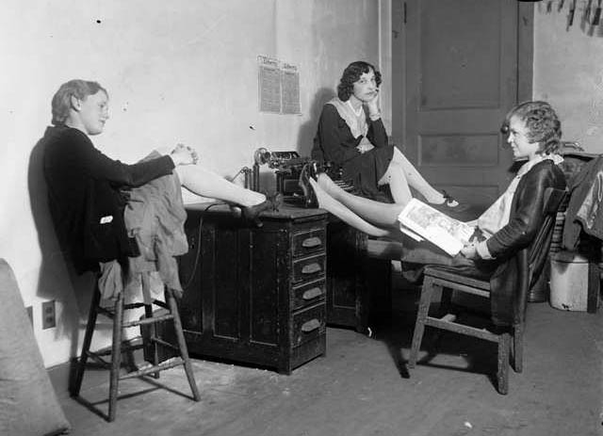
Women’s Roles
Women’s suffrage was
achieved in
The US
Britain
Germany
Sweden
Austria
Abandoned restrictive clothing and hairstyles
Wore makeup, drove cars, drank and smoked in public
Increased working opportunities
Birth control

Slide 4
Technologies
Medical treatments and drugs
The automobile
Public airlines
Entertainment: radio, movies and jazz

Slide 5
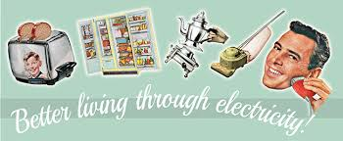
Electricity
Electricity available to the general public
Allowed for more leisure time
Inventions included
The washing machine
Electric refrigerator
Vacuum cleaner
Coffee pot

Slide 6
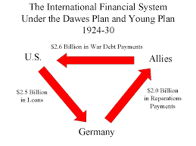
Depression
New European governments were unstable
Germany printed so much money it became essentially worthless
Trade diminished
Reparations: many
countries owed money,
but particularly
Germany
US stock market crash

Slide 8
Britain
Slowly improved economy by
Raising taxes
Increasing tariffs
Regulating currency
Lowering interest rates
Avoided political extremes and maintained democracy

Slide 9
France
Faired better economically than most because
Agricultural economy
Largely self-sufficient
Little need for foreign trade
Political instability- multiple governments formed and fell
Created a Populist Front to help workers.
no long lasting good
but did hold on to democracy

Slide 10
Scandinavian countries
Socialist government
Raised taxes
Increased pensions and unemployment benefits
Subsidized housing
Democracy intact

Slide 11
United States
Roosevelt’s New Deal
Public works projects for unemployed
Aid to businesses and farms
Relief programs
Regulations for banks and stock exchange
Democracy maintained

Slide 13
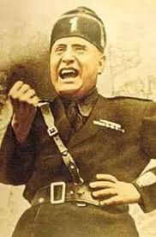
Italy
Unemployment and inflation high
Looking for strong leader
Fascism: a new, militant political movement that emphasized loyalty to the state and obedience to the leader
Extreme form of nationalism
Dictatorial rule
Each class has its own place in society
Denies individual rights
Mussolini promised to rescue Italy by reviving its economy and rebuilding its army
Gained full power in 1922

Slide 14
The Fascist State
Mussolini
Eliminated all other political parties
Curbed freedom of the press
Outlawed free speech and association
Crushed labor unions and prohibited strikes
Allied himself with business and landlord interests
Labeled Jews unpatriotic and banned them from government employment
Mussolini may have done many brutal and tyrannical things; he may have destroyed human freedom in Italy; he may have murdered and tortured citizens whose only crime was to oppose Mussolini; but one had to admit one thing about the Dictator: he “made the trains run on time.”
Ashley Montagu and Edward Darling

Slide 15
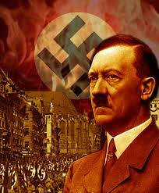
Germany
Nationalist Socialist German Workers’ Party, Nazi Party
Goal: overturn Treaty of Versailles and combat communism
Hitler joined in 1919
Arrested and jailed in attempt to seize power
Wrote Mein Kampf: outlined his goal for an Aryan nation, master race, and to regain lands and decrease population
Gained power when US aid stopped, German economy collapsed
1932- Hitler became Chancellor
Became totalitarian state
Established SS- arrested and murdered all enemies
Successfully boosted economy, decreased unemployment
Began attack on non-Aryans (Night of Broken Glass)

Slide 16
Rise of Hitler
In July 1932 the Nazi Party won 37.3% of the vote (230 parliamentary seats) and became the largest party in the Reichstag
The Communist Party also did well and fear of communism reinforced Hitler’s appeal
On Jan 30, 1933, Hitler became chancellor
Dec 21, 1931

Slide 17
Germany under Hitler
Declared a national state of emergency
Eliminated all opposition
Outlawed all other political parties and made the National Socialist Party (Nazis) the only legal party
Replaced the federal structure with a highly centralized state
Eliminated trade unions and collective bargaining; prohibited strikes and lockouts
Took control of all police forces

Slide 18
Other countries fall to dictators
Hungary
Poland
Yugoslavia
Albania
Bulgaria
Romania
Argentina

Slide 19
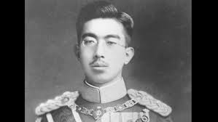
Japan
Politically democratic
Armed forces under own control
Hirohito named emperor with support of military

Slide 20
Imperialism (again)
Military forces sought an empire:
Imperialism
Japan invaded China’s Manchuria contrary to treaty (19330
1937- took northern China cities: Beijing and Nanjing
League of Nations powerless

Slide 21
Ethiopia
Mussolini attacks Ethiopia
Getting even for Italian failure to claim Ethiopia in 1890s
League of Nation failed again

Slide 22
Rhineland
Germany entered the Rhineland
Industrial area
Buffer between Germany and France
“protected” in Treaty of Versailles
Then took Austria and Czechoslovakia’s Sudetenland into German Empire
League allowed it
Appeasement: giving in to an aggressor to avoid war
Hitler’s power and confidence
increased

Slide 23
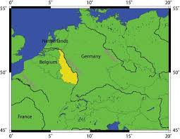
Rhineland

Slide 24
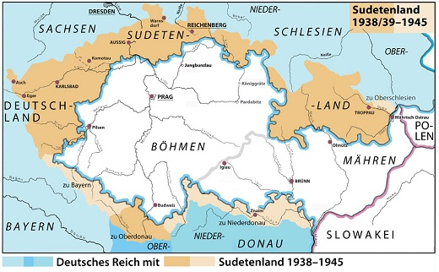
Sudetenland

Slide 25
HEADING TOWARDS WAR
Italy, Germany and Japan alliance formed
Axis Powers
All fascist countries
Hitler and Mussolini helped Franco gain fascist rule in Spain
Spain remained non-belligerent in WW2, but supplied the Axis powers
US maintained isolationism

