Slide 1
The Renaissance
1300-1600
Europe

Slide 2
Renaissance means rebirth. It was a period of new thinking and a re-examination of the old classics and a revival of art and learning.
It started in Italy for three reasons
Thriving cities
A wealthy merchant class
The classical heritage of Greece and Rome

Slide 3
Spurred by
Spreading of new ideas through Gutenberg’s printing press
Printed materials put into the hands of the common man for the first time
New sailing technology
Waning church power
Questioning minds
Spirit of exploration related to Marco Polo’s published accounting of his journey to China

Slide 4
New focus on humanism
People began to turn away from the dominant ideals put forth by the church
Religion remained the greatest influence, but this brought more of a recognition of human potential and scientific inquiry

Slide 5
God God God God
Man Man Man Man

Slide 6
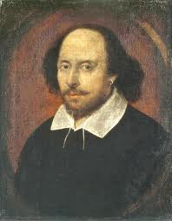
Writers
Left religious ideas
No longer about Christian heroes or living a pious life.
Broke from tradition and presented a more realistic version of life
Common people could enjoy tales
Shakespeare wrote about daily life and average people.

Slide 7
Machiavelli
“The Prince”
Political philosophy
It is okay to commit evil for the greater good.
Today, to be Machiavellian means willing to commit evil for personal gain

Slide 8
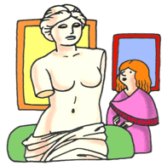
Art
Like writing, artists broke from traditions
Used perspective and techniques using light, shade and colors.
Realism:
human figures instead of religious figures
the true human spirit, not heavenly

Slide 10
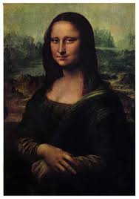
Leonardo da Vinci
Used scientific observation
Studied human anatomy
Dissected dead people in order to study bones and other parts of the body.
Interested in mechanics
Drew plans for an airplane, a helicopter and a parachute.

Slide 15
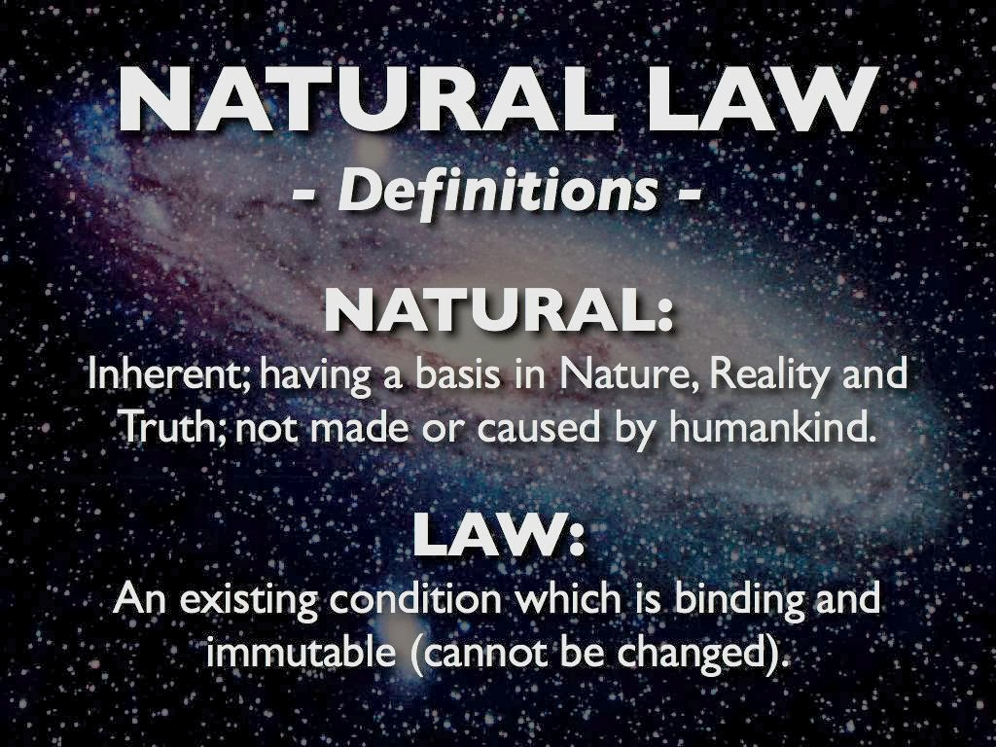
Science
Huge boom in science

Slide 17
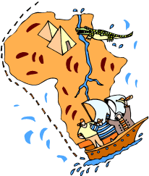
Exploration
A new spirit arose
Navigators wanted new routes to promising lands
Columbus went looking for a way to China to procure for Spain, the riches described by Marco Polo .

