Slide 1
Ottoman Empire
Notes:
Remember, the Renaissance was happening 1300-1600.
This was happening in Italy and Northern Europe.
The rest of Europe, primarily non-Christian Europe, was following a different set of events, focused on the Ottomans.

Slide 2
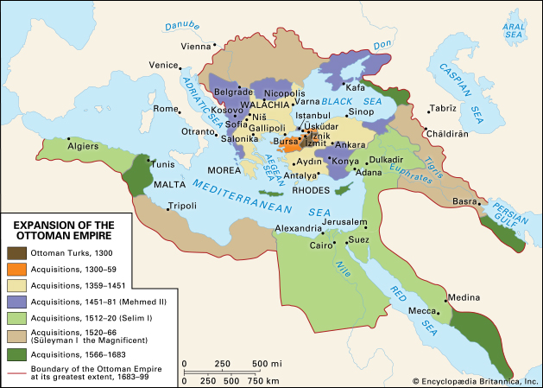
Notes:
As you can see, the Ottoman Empire spread greatly during the same period as the Renaissance. Look where it did and did not go.
Surrounded the Mediterranean at its height.

Slide 3
Reasons for Expansion
Byzantine Empire had declined.
A strong leader emerged who successfully united the Turks.
Location allowed them to be strong in trade.
Wished to spread Muslim religion.
Wished for power/land.
Had strong military.
Notes:
Byzantines were weak. Were not united. No central power.
Strong Turkish leader emerged and started the expansion. He united the Turks and created an empire that stretched across three continents: Europe, Asia, Africa.
Strong sense of religious mission- Ottomans were devout Muslims
Political opposition was executed, including family
Offered a form of religious freedom. Practice faith but not take government position.
What drove them was not any different from anyone else.

Slide 4
Ottoman Contributions
Tulips
Coffee (alternative to wine)
Science encyclopedia
Development of hospitals and healthcare
Centers of learning
Code of law
Taj Mahal
Notes:
Taj Mahal- memorial to a ruler’s wife

Slide 5
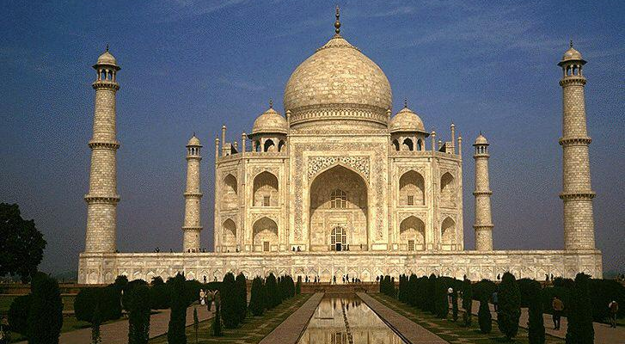
Taj Mahal

Slide 6
Decline
Less developed technology
Famine
Drained finances
WWI
Notes:
Eventually decline was due, in part, to less developed technology, particularly weaponry.
Finances drained from war and building expensive monuments
Other countries gained trade
Final dissolution of the Ottoman Empire was a consequence of WWI when Allied forces defeated Ottoman forces in the Middle East

