Slide 1
AOHS
Health Careers Exploration
Unit 1, Lesson 2
A Brief History of Medicine and Health Care
Copyright © 2012‒2014 National Academy Foundation. All rights reserved.

Slide 2
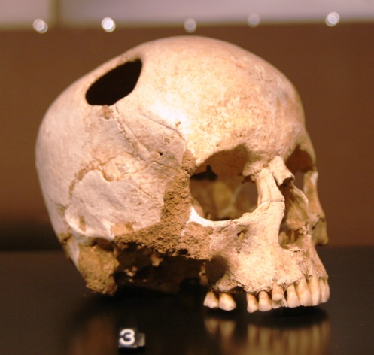
In prehistoric (ancient) times, the body was a mystery
4000 BCE – 3000 BCE
Early cultures believed that evil spirits caused disease and death.
Treatment involved trying to rid the body of evil spirits. Sometimes this was done through trepanning, or making a hole in the skull.
Medicine during this time was plant based.
These beliefs and treatments still exist in some cultures today.
Skull with trepanning hole
What do you think people needed to know about the world to understand there are natural explanations for disease and death?

Slide 3
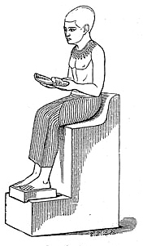
In ancient Egypt, physicians were also priests
3000 BCE – 300 BCE
The priest Imhotep is believed to be the first physician.
Ancient Egyptians were the first people to keep health records.
Egyptians held religious ceremonies to heal the sick.
Depiction of Imhotep
What qualities or behaviors would lead people to believe that the priest Imhotep was the first physician?

Slide 4
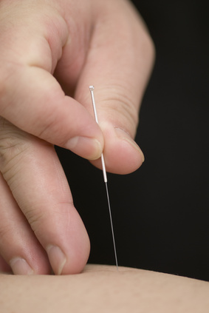
The ancient Chinese used holistic medicine
1500 BCE – 200 CE
The ancient Chinese believed that a person becomes sick when the energy flow in his or her body is blocked.
Acupuncture, or puncturing the skin with needles, was one method they used to stimulate the flow of energy.
Acupuncture is still a common practice today.
Have you or anyone you know practiced a type of holistic medicine? What were the benefits? How would you define holistic medicine?

Slide 5
Ayurveda, a type of holistic medicine, emerged in ancient India
1500 BCE – circa 1100 CE
Ayurvedic practitioners believed the human body is made up of elements similar to those of the universe, like air, fire, and water. In a healthy body, these elements are in harmony.
Ayurvedic treatments include massage, exercise, and herbal medication.
Modern-day Ayurvedic pharmacy
Ayurvedic medicine is still sold in pharmacies in India today.

Slide 6
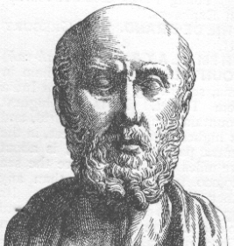
The ancient Greek Hippocrates is believed to be the father of modern medicine
1200 BCE – 200 BCE
Hippocrates figured out that there were natural explanations for disease and death.
He promoted cleanliness to prevent disease.
The Hippocratic Oath, a code of ethics for doctors to follow, comes from Hippocrates.
What do you know about the Hippocratic Oath? Why is it important that doctors follow an ethical code of behavior?

Slide 7
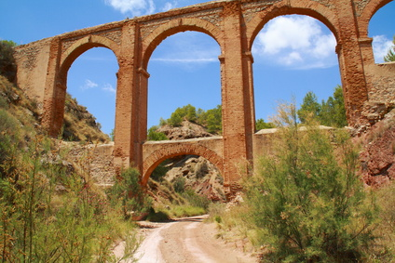
Ancient Romans focused on sanitation
750 BCE – 400 CE
The ancient Romans improved public health. They built aqueducts that brought clean water to people, and they removed garbage from city streets.
How quickly do you think public health would deteriorate if we didn’t have sewers and access to clean water?

Slide 8
Medical advances stopped during the Dark Ages
400 – 800 CE
Cause
Fall of the Roman Empire
Effects
Study of medicine prohibited
Rampant epidemics
No major breakthroughs in medicine or health care

Slide 9
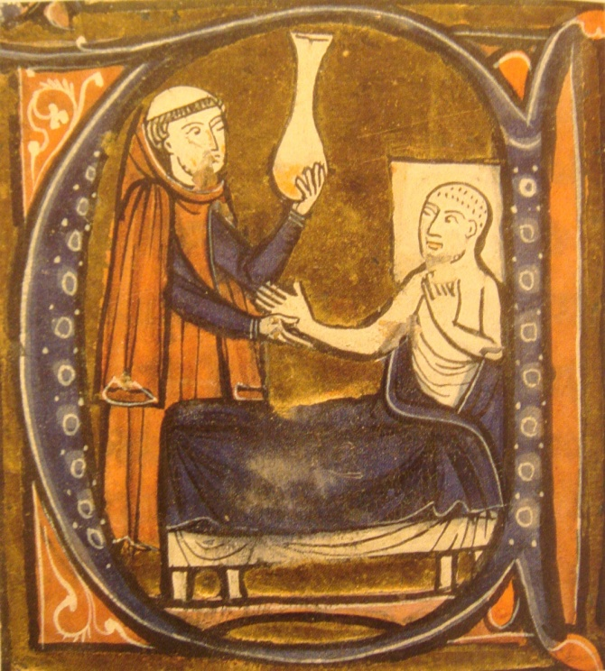
During the Middle Ages, the study of medicine resumed
800 – 1400
Students attended the first medical universities during the 9th century.
In the Arab world, doctors had to pass tests and get licenses.
The Arab physician Rhazes began to identify the differences among major diseases.
Depiction of Rhazes practicing medicine
Why do you think that being able to distinguish between the symptoms of different diseases was important?

Slide 10
During the Middle Ages, disease was rampant
800 – 1400
Spread of bubonic plague
75% of population in Asia and Europe died
Do you think there is a greater or lesser risk for epidemics now? Why?

Slide 11
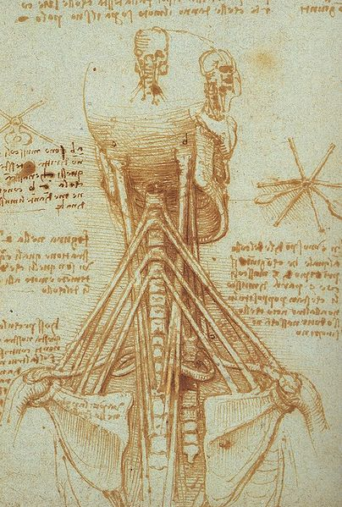
Dissection of the human body began during the Renaissance
1350 – 1450
Artists like Michelangelo and Leonardo da Vinci created drawings of the inside of the human body.
These drawings helped scientists understand the parts of the body and how they worked.
Do you think medicine would have been able to progress without an understanding of anatomy? Why or why not?
Drawing by Leonardo da Vinci

Slide 12
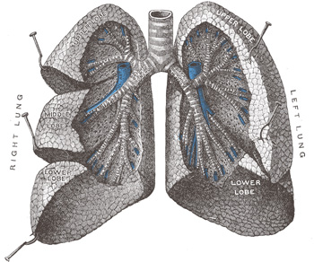
The Renaissance brought new medicines and understanding of how the human body works
1350 – 1450
Roger Bacon advanced the use of chemical remedies.
Michael Servetus described the way the lungs and circulation work. He also explained digestion.

Slide 13
What have you learned so far about the history of medicine?
Which discovery do you think was most important to the advancement of medicine? Why?
Which ancient civilization do you think made the most progress in medicine? Why?

Slide 14
Great strides were made in the 16th, 17th, and 18th centuries
1500 – 1799
Discovery of the tube connecting the ear and throat
Beginnings of modern surgery, including the first cesarean section
Invention of bifocal glasses, the thermometer, and the microscope
Learned that limes prevent scurvy
Smallpox vaccine developed
First pharmacists

Slide 15
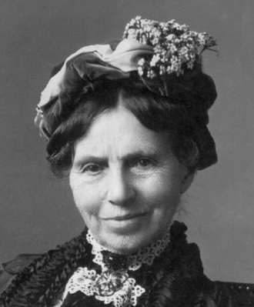
The 19th century’s Industrial Revolution impacted medicine
1800 – 1899
Women had important roles:
Clara Barton founded the American Red Cross
Florence Nightingale was the founder of modern nursing
Medicine grew rapidly:
Stethoscope and hearing aid invented
Safer surgery with antiseptics
First blood transfusion
Vaccines for fatal diseases
Clara Barton

Slide 16
Louis Pasteur’s discoveries saved millions of lives
1800 – 1899
Pasteur developed a theory that germs cause disease. He proved that heat can be used to kill harmful germs in food like milk. The process is called pasteurization.
Pasteur also developed vaccines against rabies and other diseases.
Pasteur’s ideas about sanitation helped control the spread of disease.
Why do you think the discovery that germs cause disease was a major breakthrough in medicine?

Slide 17
Medicine changed dramatically in the 20th century
1900 – 1999
X-ray, CAT scan, and MRI
Identification of blood groups
Viruses grown in cultures
Penicillin, insulin for diabetes, polio and chickenpox vaccines
Open-heart surgery and organ transplants
In vitro fertilization
Advances in psychology and psychiatry
What new professions do you think emerged in the 20th century because of the advances in medicine?

Slide 18
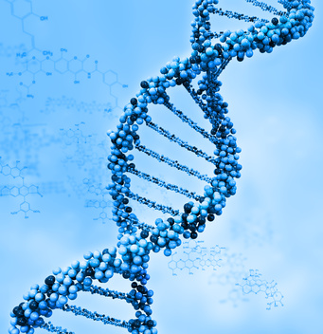
In 1952, the structure of DNA was discovered
1900 – 1999
The first use of gene therapy to treat disease occurred in 1990. Today, scientists are excited that the study of gene therapy may lead to a cure for most inherited diseases. This research wouldn’t have been possible without the discovery of DNA.
What do you know about DNA? Explain what DNA is in your own words.

Slide 19
Health care legislation characterized the 20th century
1900 – 1999
There were a number of legal and social battles in the 20th century about how to provide affordable health care.
1965: Medicare and Medicaid were introduced.
1990: The Americans with Disabilities Act made it illegal to discriminate based on disability.
1996: HIPAA protects patient privacy and made it easier to get health insurance

Slide 20
The 20th century began and ended with major pandemics
1900 – 1999
Influenza pandemic
1918
21 million people killed
AIDS
Discovered in 1981
Over 25 million killed; still claiming lives
What effect do you think the discovery of AIDS/HIV had on people in your parents’ generation? How has it impacted your generation?

Slide 21
The 21st century ushers in the Affordable Care Act
2000 – 2099
Young adults covered under parents’ insurance
Prohibits pre-existing condition exclusions
Requires most insurance plans to offer free preventive services
Allows Americans to purchase insurance plans through online Health Insurance Marketplaces
Do you think health care should be free for all Americans? Do you think Americans should be required to have health insurance?

Slide 22
Major discoveries will be made in the 21st century
2000 – 2099
So far:
A human embryo was cloned.
The Human Genome Project was completed.
Scientists prepare for bioterrorist attacks and possible new pandemics, like the bird flu virus.
Information technology is used to share knowledge between scientists and physicians all over the world.
What do you think will be some of the most important discoveries in medicine in the 21st century?

Slide 23
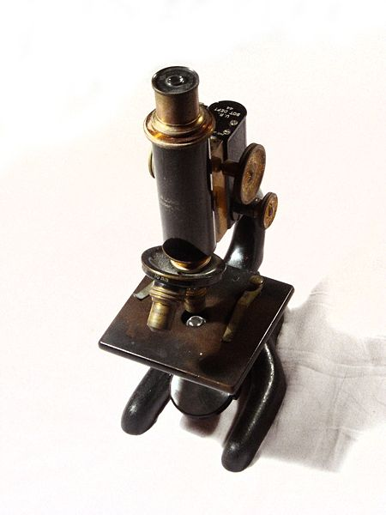
Understanding history helps us make progress
Sanitation can help prevent the spread of disease.
Chemical remedies can treat disease.
Microorganisms are the cause of disease.
Healthy organs can replace failing ones.
DNA is the building block of genetic code.
Gene therapy can be used to treat disease.

