Slide 1
Grammar Review
Test one

Slide 2
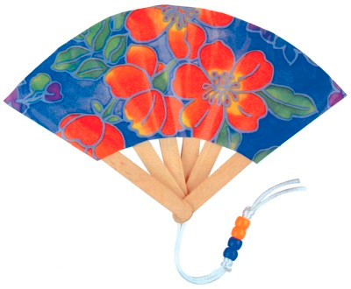
Fanboys
What are the fanboys?
List them.

Slide 3
For
And
Nor
But
Or
Yet
so

Slide 4
Because
Because is not a coordinating conjunction.
Do not use a comma before or after the word because.

Slide 5
independent clause
An independent clause is a ________________.
It contains a ___________ and a ____________.
It is a complete _____________.

Slide 6
Dependent clause
A dependent clause is missing something.
It might be the ____________ or the _________.
It leaves the reader needing more information to be a complete ____________.

Slide 7
Are the following independent or dependent clauses?
That your friend built.
Unless Peter helps.
Who went to camp.
Who went to camp?
When I went running?
I felt great when I went running?

Slide 8
Coordinating conjunctions: rule
Conjunctions join things, so they should not start a sentence.
If they join two independent clauses, do/do not use a comma.
If they join an independent clause and a dependent clause, do/do not use a comma.

Slide 9
Dependent clauses at the beginning of a sentence
A dependent clause sometimes starts a sentence.
When used this way, the clause should be followed with a __________.
The dependent clause can be moved to the end of the sentence. In that case, there is no _________.

Slide 10
Introductory words/phrases
Sentences can also be started with words or phrases.
Examples are however, initially, sometimes…..
When using these, they are followed by a ______.

Slide 11
Commas in a series
Commas follow all but the last item in a series of ________ or more.
An exception is if you want some of the items to seem more linked.
Example: Some of my favorite desserts are cookies, candy, ice cream and cake, and pie.

Slide 12
appositives
Appositives are surrounded by a ______ on each side.
Appositives can be removed and what is left will still be an independent clause (a sentence).
The appositive always ________ the noun it refers to.
The noun and the appositive can trade places without ________ meaning.

