Slide 1
Daily Quiz #1
1. The dominate culture in the United States in 1776 was?
a. Irish
b. English
c. German
d. Scottish
2. In 1770, America was almost completely?
a. Urban
b. Industrial
c. Rural
d. Tolerant

Slide 2
Daily Quiz #1
3. A member of a Nativist Movement believes in?
a. Increased immigration
b. American Indian rights
c. Integration of blacks and whites
d. Limiting or stopping immigration
4. Which is NOT a way the wealthy viewed immigrants?
a. Source of cheap labor.
b. Members of the political process.
c. Sources of Radical ideas.
d. A tool to break up labor unions

Slide 3
Daily Quiz #1
5. Which profession were immigrants the least likely to be found in?
a. Coal Miners
b. Meat Packing
c. Teachers
d. Textile/Garment Industry

Slide 4
The Gilded Age
First Era of Conspicuous Consumption
Corporate Giants Grew
Middle Class Grew
Social Unrest Grew

Slide 5
The Gilded Age
Americans who achieved wealth celebrated it as never before.
In New York, the opera, the theatre, and lavish parties consumed the ruling class' leisure hours.
Sherry's Restaurant hosted formal horseback dinners for the New York Riding Club.
Mrs. Stuyvesant Fish once threw a dinner party to honor her dog who arrived sporting a $15,000 diamond collar.

Slide 6
Gilded Age

Slide 7
The Gilded Age’s Poor
In 1890, 11 million of the nation's 12 million families earned less than $1200 per year
The average annual income was $380, well below the poverty line.
Rural Americans and new immigrants crowded into urban areas.
Tenements spread across city landscapes, teeming with crime and filth.
Americans had sewing machines, phonographs, skyscrapers, and even electric lights, yet most people labored in the shadow of poverty.

Slide 8
The Gilded Age
In general, an increasing concentration of wealth and power
Business and government became bigger while they became intertwined.
Lasting Results –
The federal government uses its power and money to encourage businessmen to build railroads
All levels of government had become more involved in the nation's economic welfare.

Slide 9
Power of Wealth

Slide 10
Ghettos in the Gilded Age Why?
Disparity in Wealth
Social Darwinism
Charles Darwin’s Theory of Natural Selection
Survival of the Fittest
Applied to society
“Protestant Work Ethic”
They are poor so they deserve to be so
“Not my problem”

Slide 14
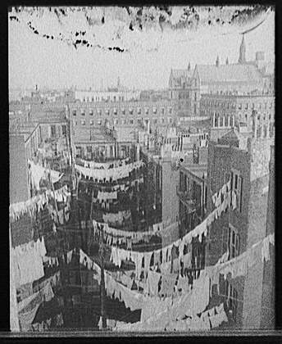

Slide 15
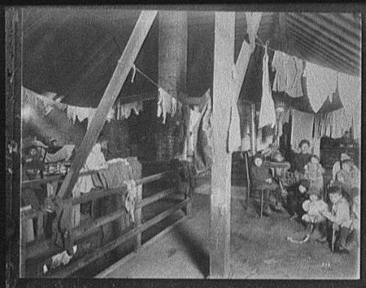

Slide 16
Life on the Low Side

Slide 17
Life on the Low Side

Slide 18
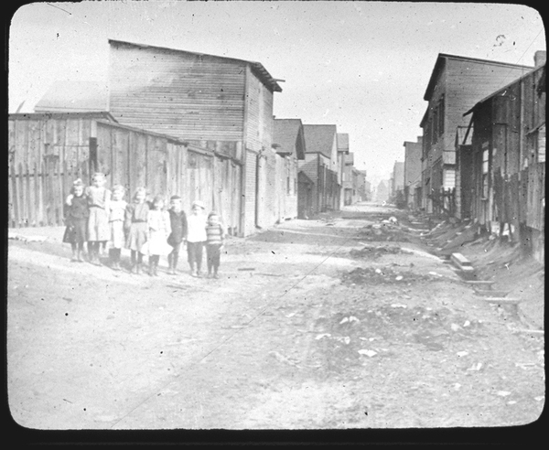
Life on the Low Side

Slide 19
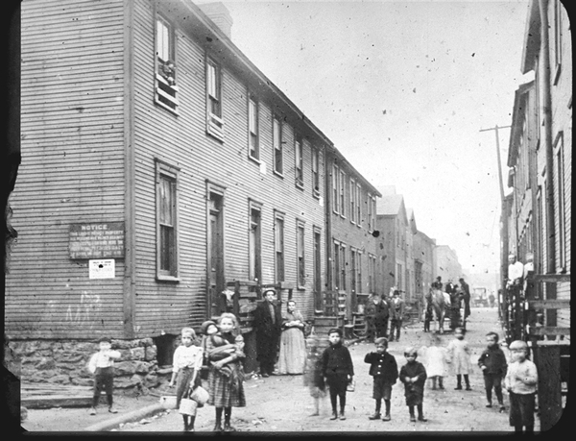
Life on the Low Side

Slide 20
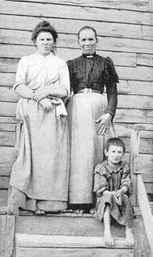
Life on the Low Side - Coal

Slide 21
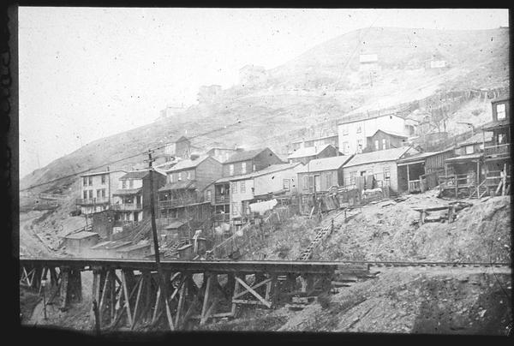
Life on the Low Side

Slide 22
Life on the Low Side - Coal

Slide 23
Life on the Low Side - Coal

Slide 24
Life on the High Side
The Breakers is the grandest of
Newport's summer "cottages"

Slide 25
Life on the High Side

