Slide 1
Impact of WWI on the World

Slide 2
World War I
Killed more than 9 million soldiers, sailors and flyers, and 5 million civilians
Left at least 7 million men permanently disabled
Involved 28 countries
Cost $186 billion in direct costs and another $151 billion in indirect cost

Slide 3
Technology
Tanks
Poison gas
Weaponry usable on planes
Depth charges
Aircraft carriers
Pilotless drones
Mobile x-ray machines

Slide 4
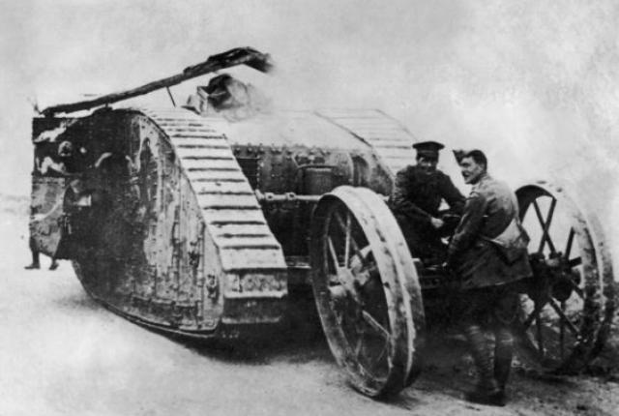
Notes:
The tank- first used in Battle of Somme by the British- 1916
Could get across land that previously would see rifle fire taking people down.

Slide 5
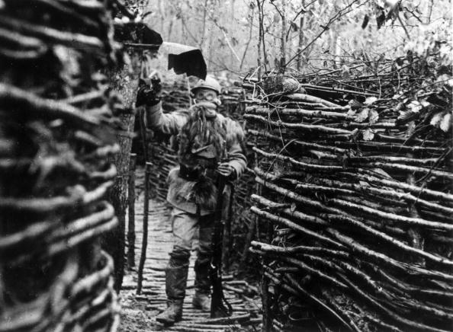
Notes:
Poison gasses- first used by Germany but quickly used by Allies as well.
Did little to change the outcome of the war, but was responsible for great misery- many deaths

Slide 6
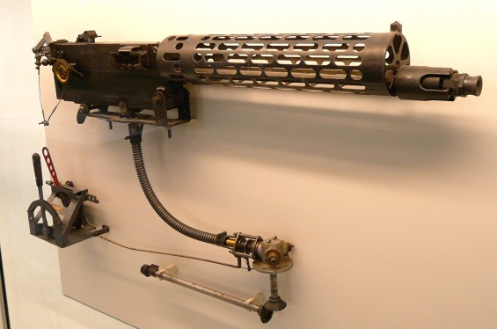

Slide 7
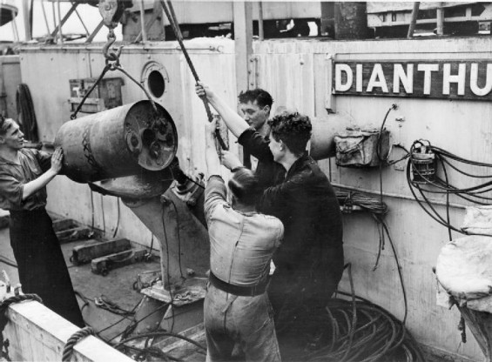
Notes:
Depth charges could take out submarines

Slide 8
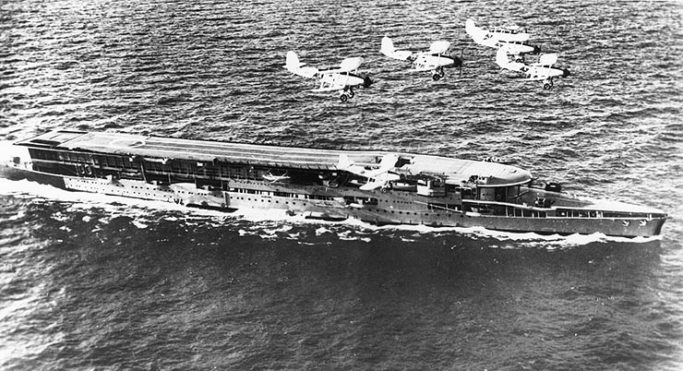

Slide 9
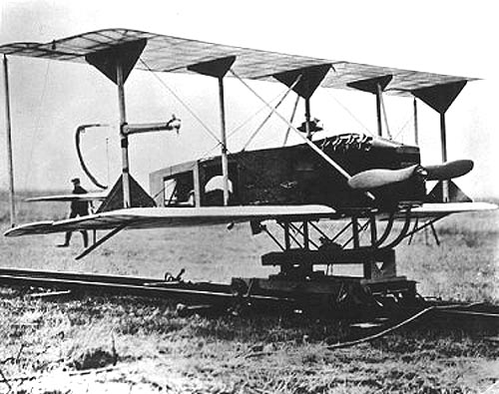
Notes:
Pilotless drones- could be used as an unarmed bomb

Slide 10
Social and Political Changes
The war aided the rise of extremism by weakening Europe’s confidence in the social order.
Fascism
Communism
German and Austrian monarchies were replaced by shaky republics. Russia and Turkey also saw the downfall of their monarchies.
Church attendance declined while recreational drug use rose.
Germany felt victimized in the Treaty of Versailles, leading to unrest.
The US became the world’s economic leader.
In the US, women moved towards getting the vote.

