Slide 1
AOHS
Global Health
Unit 1, Lesson 2
Health Status Indicators: Life Expectancy
Copyright © 2012–2014 National Academy Foundation. All rights reserved.

Slide 2
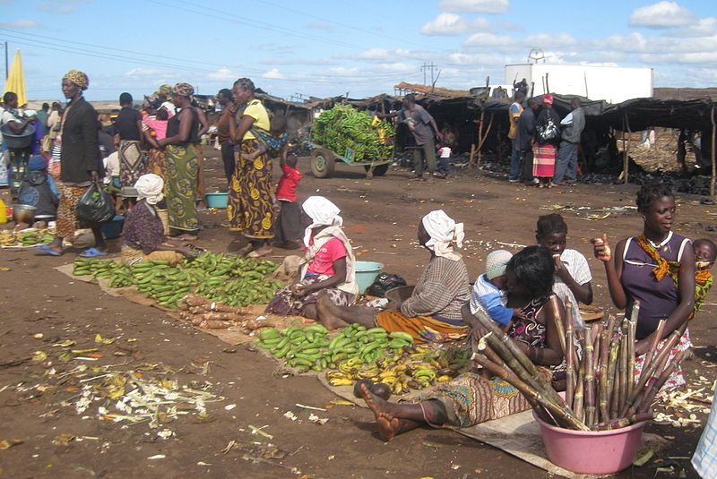
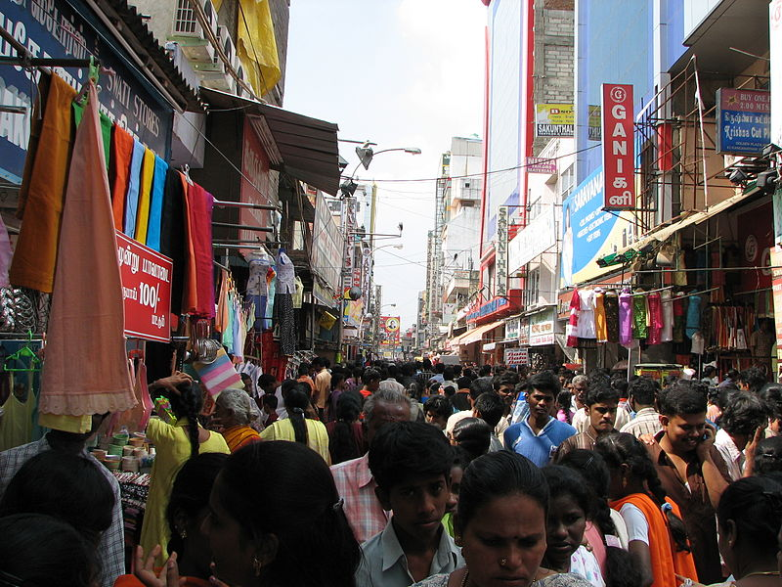
Health status indicators measure the health of a population
Measurements called health status indicators are used to assess the health of populations around the world, from farmers in Uganda to city dwellers in India.
If you were trying to determine the health of a population, what are some of the things you would want to measure?
Notes:
Image retrieved from http://commons.wikimedia.org/wiki/File:India_-_Sights_%26_Culture_-_001_-_crowd_shopping_%28342043908%29.jpg on August 9, 2013, and reproduced here under the terms of the Creative Commons Attribution 2.0 Generic license (http://creativecommons.org/licenses/by/2.0/deed.en). Image courtesy of McKay Savage.
Image retrieved from http://commons.wikimedia.org/wiki/File:Chimoio_market_-_banana_sellers.jpg on August 9, 2013, and reproduced here under the terms of the Creative Commons Attribution 2.0 Generic license (http://creativecommons.org/licenses/by/2.0/deed.en). Image courtesy of Ton Rulkins.

Slide 3
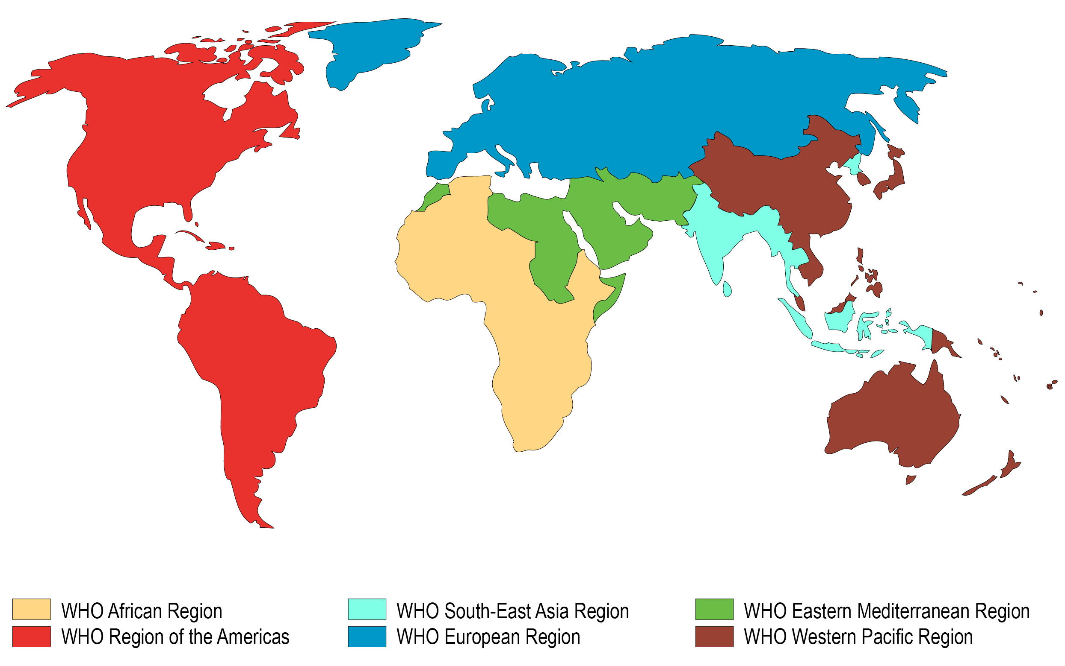
The World Health Organization (WHO) measures health by region
Copyright © World Health Organization. All rights reserved.
Compare your world map to this WHO regional map. How many WHO regions are there in Asia? Is Africa its own region?
Notes:
Data from http://www.who.int/about/regions/en.

Slide 4
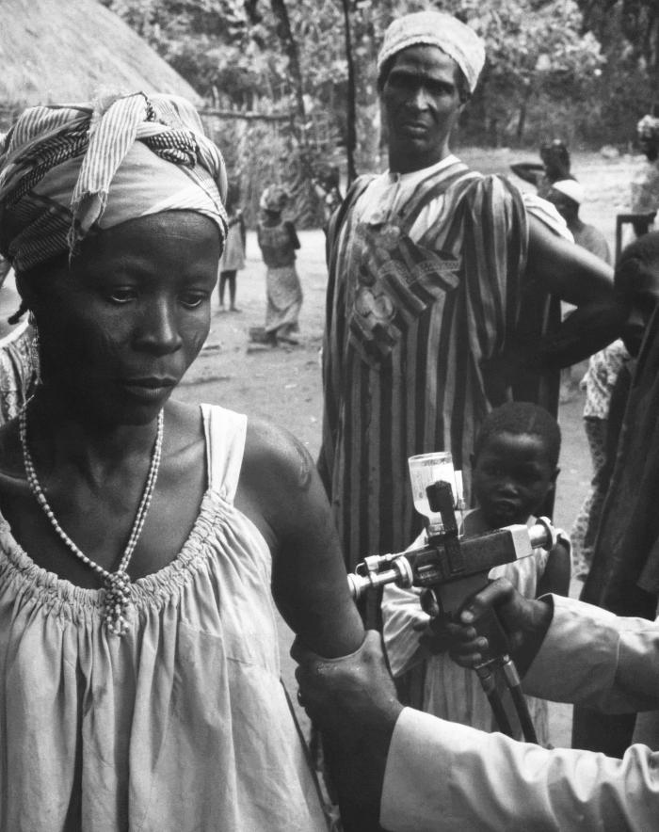
The WHO provides leadership on all global health issues
The idea of setting up a global health organization originated with the United Nations.
The WHO is now involved in all aspects of global health.
Professionals who work for the WHO measure and monitor the status of health around the world.
The WHO was a leader in the smallpox eradication program. This image shows a woman being vaccinated in Niger in 1969.
Notes:
Image retrieved from http://phil.cdc.gov/phil/details.asp on August 9, 2013. From CDC/ J. D. Millar, MD.

Slide 5
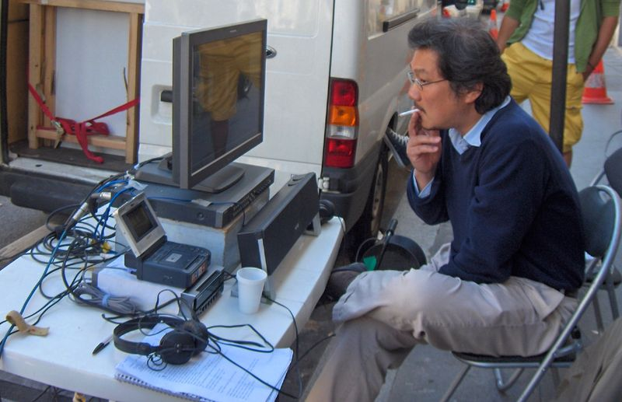
Health status indicators can answer important questions
What health conditions are people suffering from?
Which of these conditions cause people to be sick or disabled or to die?
How fast is a disease spreading?
Is a society’s health status improving?
Health status indicators might take into consideration what type of work people do, whether they smoke, and what their diet is like.
What other questions might professionals ask to determine the health status of a population based on complete physical, mental, and social well-being?
Notes:
Image retrieved from http://commons.wikimedia.org/wiki/File:2007-09-05_Hong_Sang-soo_sur_Nuit_et_Jour.JPG on August 9, 2013, and reproduced here under the terms of the Creative Commons Attribution 3.0 Generic license (http://creativecommons.org/licenses/by/3.0/deed.en). Image courtesy of Étienne André.

Slide 6
One way to measure health: look at how long people live
The WHO tracks the following information:
How long people live (life expectancy)
How many people die before they are 60
How many children die before they are 5
How many children die before they are 1
How many children die in the first 28 days of life
How many mothers die in pregnancy and childbirth

Slide 7
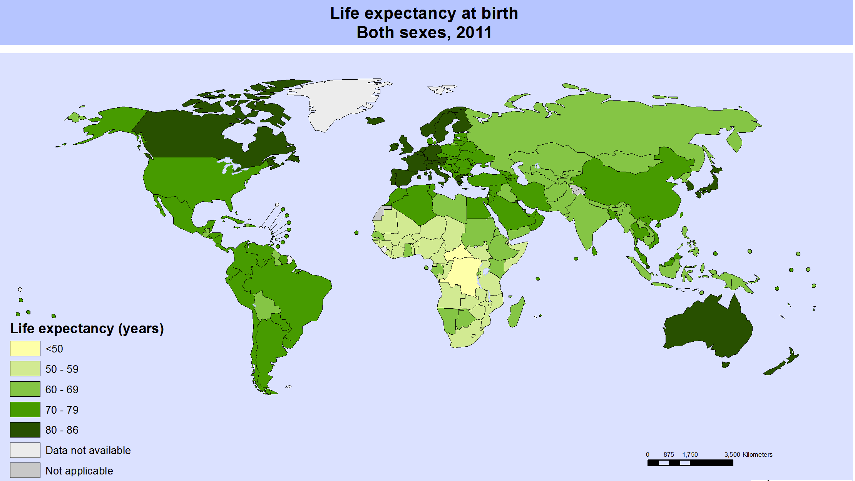
Life expectancy at birth gives an average prediction for how long someone will live
Copyright © World Health Organization. All rights reserved.
Identify a country that has a life expectancy of less than 50 years. Record information about it on your regional reference maps.
Notes:
This map is included under fair-use guidelines of Title 17, US Code. Copyrights belong to respective owners. Map available online at http://gamapserver.who.int/mapLibrary/Files/Maps/Global_LifeExpectancy_bothsexes_2011.png.

Slide 8
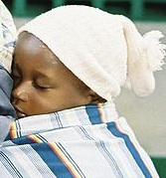
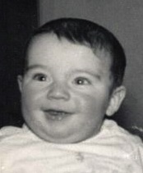
Life expectancy is influenced by when and where you are born
Born in South Africa, 2013
Born in Japan, 2011
Born in the US, 1930
Which person do you think has the longest life expectancy at birth?
Notes:
Data from https://www.cia.gov/library/publications/the-world-factbook/rankorder/2102rank.html, http://www.elderweb.com/book/appendix/1900-2000-changes-life-expectancy-united-states, and http://beta2.statssa.gov.za/publications/P0302/P03022013.pdf.
Image retrieved from http://commons.wikimedia.org/wiki/File:Young_mother_%28Klashorst%29.jpg on August 9, 2013, and reproduced here under the terms of the Creative Commons Attribution 2.0 Generic license (http://creativecommons.org/licenses/by/2.0/deed.en). Image courtesy of Peter Klashorst.
Image retrieved from http://commons.wikimedia.org/wiki/File:Best_boy_1857.jpg on August 9, 2013, and reproduced here under the terms of the Creative Commons Attribution 3.0 Generic license (http://creativecommons.org/licenses/by/3.0/deed.en). Image courtesy of Boxears.
Image retrieved from http://commons.wikimedia.org/wiki/File:Poa_Pan-milk.JPG on August 9, 2013. 2012. Image courtesy of Mattes.

Slide 9
Mortality rate measures how many people die before old age
The adult mortality rate measures the number of deaths per year per 1,000 people between the ages of 15 and 60.
It’s an important indicator because it shows where efforts can be taken to avoid early deaths.
2007 Mortality Rate for Women
United States | Afghanistan
80/1000 | 386/1000
Find Afghanistan on your map. Then fill in your map with the information that you learned on this slide.
Notes:
Data from http://www.tradingeconomics.com/afghanistan/mortality-rate-adult-female-per-1-000-female-adults-wb-data.html and http://www.cdc.gov/nchs/data/databriefs/db115.htm.

Slide 10
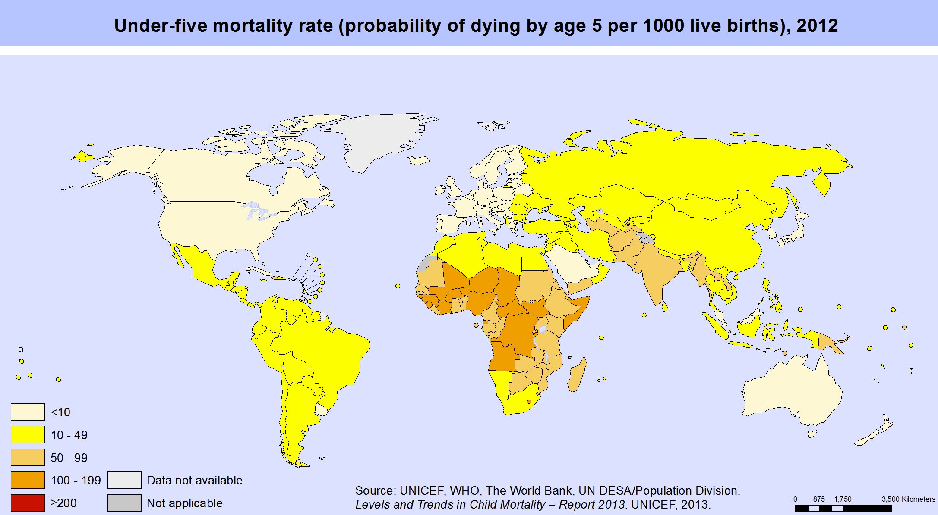
The under-5 mortality rate measures the probability that a child will die before reaching the age of 5
What is the under-5 mortality rate for Brazil?
Notes:
This map is included under fair-use guidelines of Title 17, US Code. Copyrights belong to respective owners. Map available online at http://gamapserver.who.int/mapLibrary/Files/Maps/global_underfivemortality_2012.png.

Slide 11
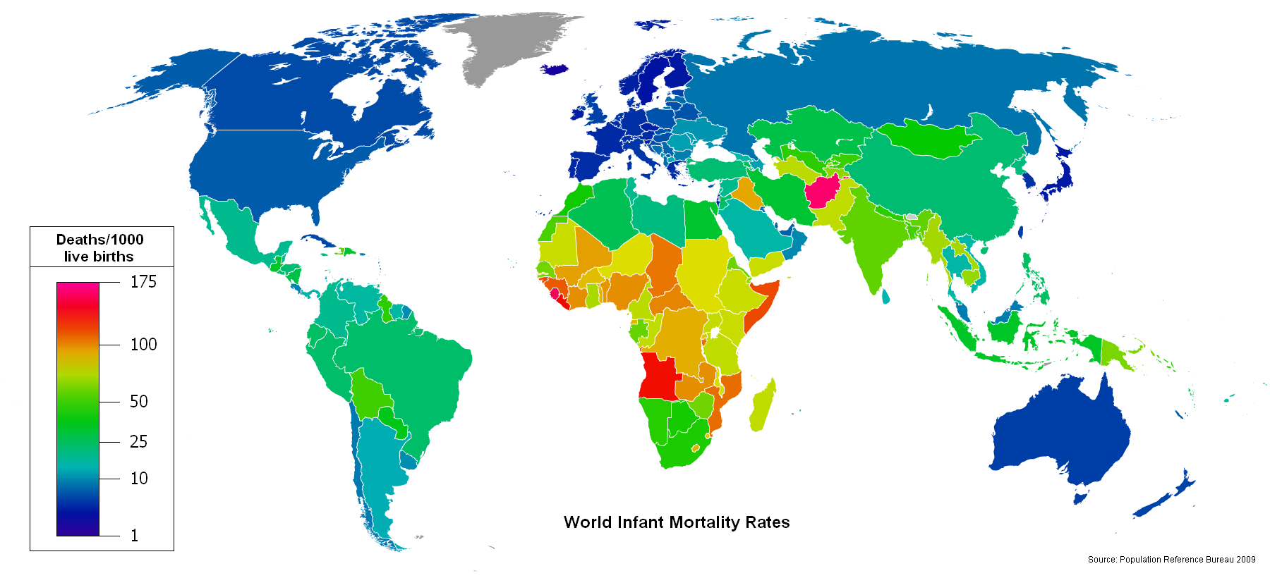
The infant mortality rate measures how many babies die in their first year of life
Determine the infant mortality rate for Spain and record the information on your regional reference map.
Notes:
This map is included under fair-use guidelines of Title 17, US Code. Copyrights belong to respective owners. Map available online at http://commons.wikimedia.org/wiki/File%3AInfant_Mortality_Rate_World_map.png.

Slide 12
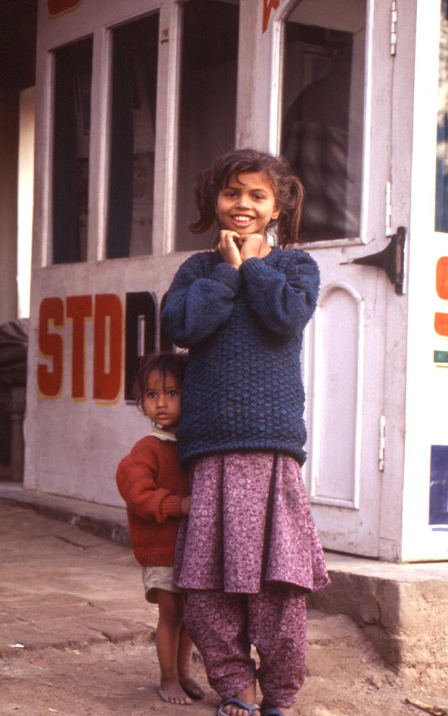
Low-income countries are making progress in reducing infant mortality rates
Over the last decades, the infant mortality rate in the poorest urban areas of Asia has seen a dramatic drop:
1990s: 81 / 1,000 live births
2007: 51 / 1,000 live births
Children in the city of Gorakhpur, India, in 2000
What do you think might have contributed to a decrease in infant mortality rates?
Notes:
Data from http://www.who.int/gho/urban_health/outcomes/infant_mortality_text/en/index.html.
Image retrieved from http://phil.cdc.gov/phil/details.asp on August 9, 2013. From Chris Zahniser.

Slide 13
Try figuring out a statistic on your own
You are going to figure out what the infant mortality rate was in the United States in 2009.
First, write down this information:
Number of live births: 4,130,665
Number of children who died before the age of 1: 28,915
You want to find out how many children out of 1,000 die before the age of 1. What equation do you think you’re going to use to calculate the infant mortality rate?

Slide 14
What was the infant mortality rate in the US in 2009?
28,915 deaths is to 4,130,665 live births as X deaths is to 1,000 live births. You want to solve for X, which is the infant mortality rate.
Here’s the equation you want to use:
28,915 deaths X deaths
________________ = ______________
4,130,665 live births 1,000 live births
Answer: The 2009 infant mortality rate in the United States was 7. That means 7 out of 1,000 children born that year died before they turned 1.

Slide 15
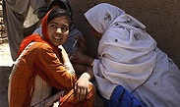
Neonatal mortality rate is another health status indicator
Neonatal is a word for “newborns” in the first 28 days of life.
Tetanus shots can reduce neonatal mortality.
Newborns get tetanus, a life-threatening condition, from their mothers.
Vaccinating young women against tetanus saves babies and mothers.
There has been a 92% reduction in deaths from neonatal tetanus.
An adolescent Afghan girl receives a tetanus vaccination outside her home.
Notes:
Image retrieved from http://www.unicef.org/health/index_43509.html on August 9, 2013. Image courtesy of UNICEF.

Slide 16
The maternal mortality rate measures how many women die during or shortly after a pregnancy
Between 1990 and 2010, maternal mortality worldwide dropped by almost 50%.
However, every day approximately 800 women die from preventable causes related to pregnancy and childbirth.
Almost all of these deaths occur in low-resource settings.
Skilled care before, during, and after childbirth can save the lives of women and newborn babies.
Notes:
Data from http://www.who.int/mediacentre/factsheets/fs348/en/.

Slide 17
Health status indicators are measurements that help us assess health populations
Life expectancy at birth measures how long people will likely live based on where and when they are born.
Mortality rate measures how many people die before old age.
Under-5 mortality rate, infant mortality rate, and neonatal mortality rate measure how many children die.
Maternal mortality rate measures how many women die during or shortly after pregnancy.

