Slide 1
AOHS
Global Health
Unit 1, Lesson 3
Communicable Disease
Copyright © 2012–2014 National Academy Foundation. All rights reserved.

Slide 2
A communicable disease is passed from one infected person to another
The range of communicable diseases is wide.
Communicable diseases include both the common cold and HIV.

Slide 3
The source of communicable diseases can be bacteria, viruses, fungi, or parasites
Bacteria | Most are harmless. Some cause infections such as strep throat. Bacterial infections can be treated with antibiotics.
Viruses | Usually make us sick. Cannot survive without a host. Can sometimes be prevented by vaccines or treated with antiviral medications. Do not respond to antibiotics.
Name two different infections. Do you think they are caused by bacteria, viruses, fungi, or parasites?

Slide 4
The mode of transmission is how the disease moves
Mode of Transmission | What It Means
Direct contact | Contact with an infected person or an infected person’s blood or body fluids
Airborne | Breathing contaminated air
Vectorborne | Spread by an animal or insect, usually the bite of an infected insect
Food- and waterborne | Eating contaminated food or drinking contaminated water
Mother to child | Passed from a pregnant woman to her baby during pregnancy, delivery, or through breast milk
Think of an infectious disease you know about. What do you think is its mode of transmission?

Slide 5
Some regions are more affected than others by death from communicable disease
Which regions have the most deaths from communicable disease? Why do you think that is?
Notes:
Data from CDC Global Health Observatory, “Causes of Death in 2008,” http://www.who.int/gho/mortality_burden_disease/causes_death_2008/en/index.html.

Slide 6
The WHO tracks several important communicable diseases
Influenza
Diarrheal diseases, including cholera
HIV/AIDS
Tuberculosis
Malaria

Slide 7
Influenza is a viral infection that is easily spread through the air or by direct contact
Seasonal influenza can cause severe illness or death in specific groups of people, like the elderly.
In some cases, a more unusual strain of influenza, like H1N1 or avian flu, can kill a higher percentage of people, even healthy individuals.
The WHO tracks the spread of influenza to make sure we stop any unusual strain before it becomes a pandemic.
How can we prevent or slow down the spread of seasonal influenza?

Slide 8
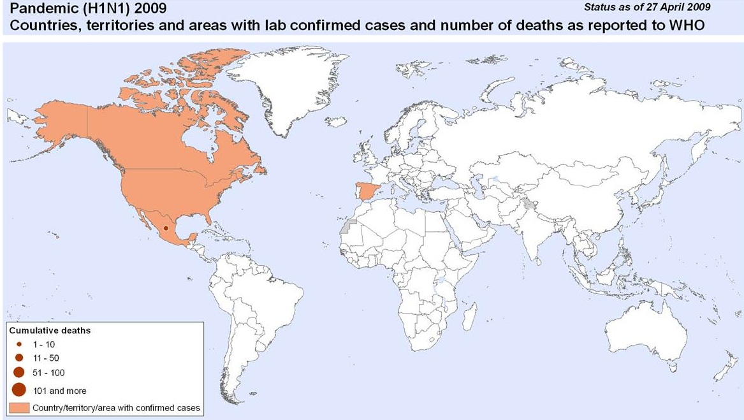
This is what the status of H1N1 looked like early on in the pandemic
Copyright © World Health Organization. All rights reserved.
Notes:
This map is included under fair-use guidelines of Title 17, US Code. Copyright © World Health Organization.

Slide 9
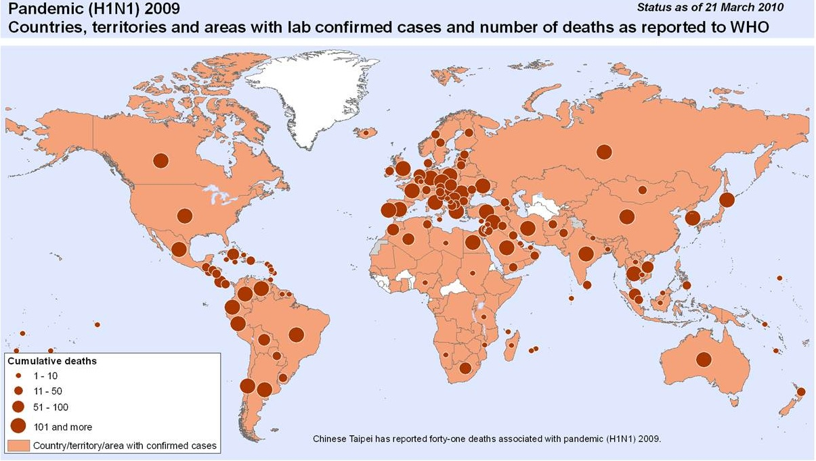
Within a year, H1N1 had spread rapidly across the globe
Copyright © World Health Organization. All rights reserved.
Notes:
This map is included under fair-use guidelines of Title 17, US Code. Copyright © World Health Organization.

Slide 10
Diarrheal disease may come from food- or waterborne infections or as a result of poor hygiene
Globally, there are about 1.7 billion cases of diarrheal disease every year.
It is the second leading cause of death in children under 5 years old even though it is preventable and treatable.
Diarrhea drains the body of water and salts; if diarrhea is left untreated, the patient can die from severe dehydration.
Why do you think it is mostly children who die from diarrheal disease?
Notes:
Data from WHO, “Fact Sheet 330: Diarrhoeal Disease,” http://www.who.int/mediacentre/factsheets/fs330/en/index.html.

Slide 11
Diarrheal disease occurs in every region, but deaths are far more common in developing countries
Notes:
Data from WHO, “Fact Sheet 330: Diarrhoeal Disease,” http://www.who.int/mediacentre/factsheets/fs330/en/index.html.

Slide 12
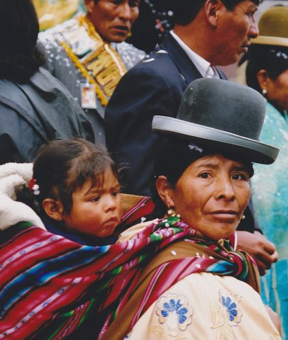
Vaccines are decreasing diarrheal death in Bolivia
Rotavirus is a diarrheal disease that hospitalizes many children in Bolivia.
The country has been actively working to vaccinate children against the disease.
The vaccination program is working. Fewer children are getting severely sick.
The rotavirus vaccine was 70–76% effective in preventing the disease.
Notes:
Data from GAVI Alliance, “Bolivia’s Successful Rotavirus Vaccine Initiative,” http://www.gavialliance.org/library/news/roi/2010/bolivia-s-successful-rotavirus-vaccine-initiative/.
Image retrieved from http://commons.wikimedia.org/wiki/File:Mother_and_child_in_Bolivia.jpg on August 18, 2013, and reproduced here under the terms of the Creative Commons Attribution 2.0 Generic license (http://creativecommons.org/licenses/by/2.0/deed.en). Image courtesy of Peter van der Sluijs.

Slide 13
Cholera is a waterborne diarrheal disease that is particularly dangerous
This bacterium infects the small intestine, causing diarrhea and vomiting. If untreated, cholera can cause death within hours.
The WHO estimates that there are 3 to 5 million cases of cholera every year, with 100,000 to 120,000 deaths.
Cholera can be prevented by working to ensure safe drinking water and good sanitation.
Most cases are in Africa and Southeast Asia.

Slide 14
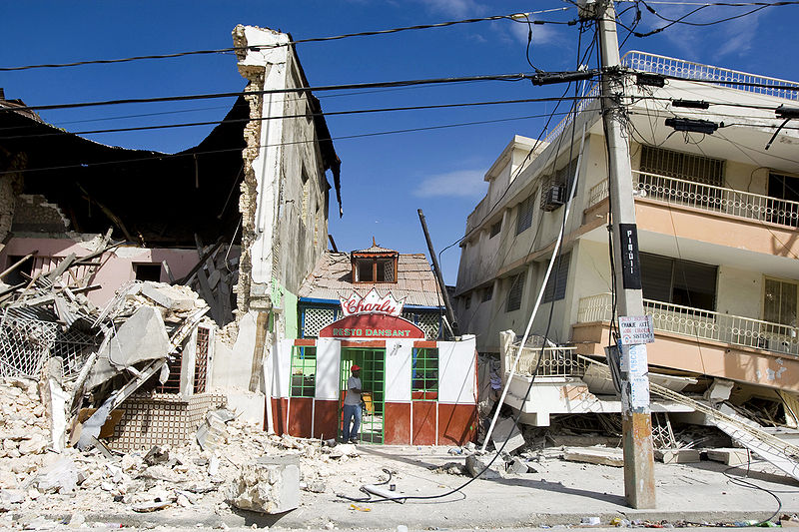
A cholera outbreak in Haiti took many lives
Major earthquake
Infrastructure damage
Cholera outbreak
Poor sanitation and drinking water
The devastating earthquake destroyed much of the capital city
After the earthquake, many people were forced to live in refugee camps. How do you think this contributed to the spread of cholera?
Notes:
Data from WHO, “Fact Sheet 107: Cholera,” http://www.who.int/mediacentre/factsheets/fs107/en/index.html.
Image retrieved from http://commons.wikimedia.org/wiki/File:Haiti_Earthquake_building_damage.jpg on August 29, 2013, and reproduced here under the terms of the Creative Commons Attribution 2.0 Generic license (http://creativecommons.org/licenses/by/2.0/deed.en). Image courtesy of Marco Dormino/The United Nations.

Slide 15
HIV/AIDS is transmitted through direct contact
HIV/AIDS attacks the immune system, so a patient can’t fight off disease.
According to estimates by WHO and UNAIDS:
34 million people were living with HIV at the end of 2011.
There were 2.5 million new infections that same year, and 1.7 million AIDS-related deaths.
More than 2/3 of new HIV infections were in sub-Saharan Africa.
Do you know specific ways that HIV/AIDS is transmitted?
Notes:
Data from WHO, “HIV/AIDS,” http://www.who.int/features/qa/71/en/index.html.

Slide 16
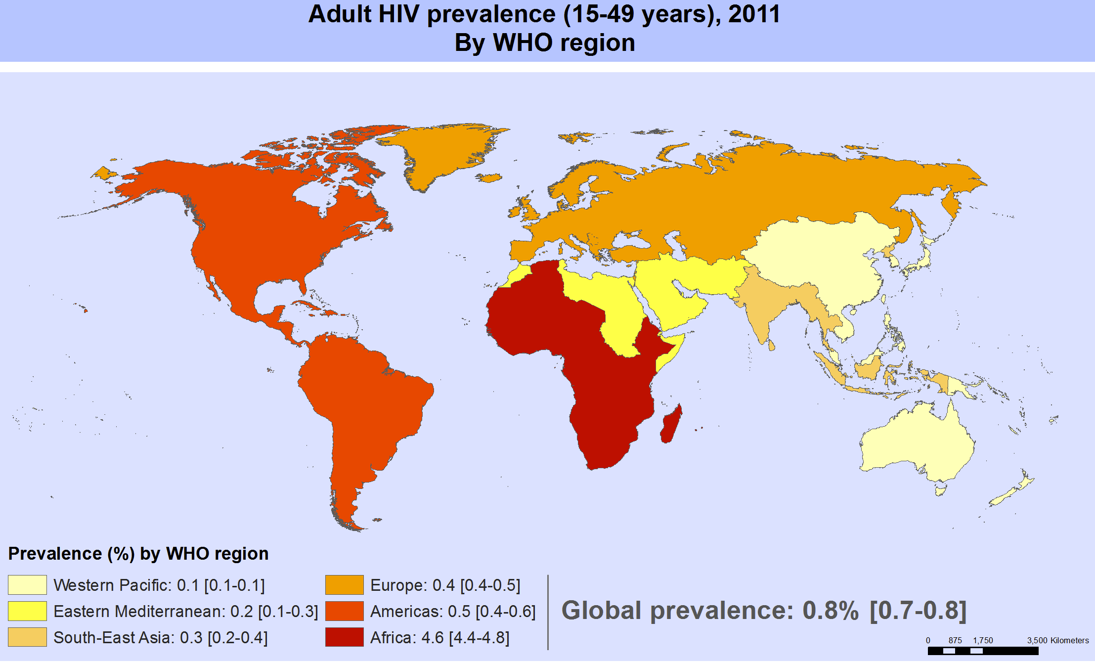
HIV is a problem in every region of the world
Copyright © World Health Organization. All rights reserved.
The legend shows 0.5% of the population in the Americas is living with HIV. How does that compare to Africa?
Notes:
This map is included under fair-use guidelines of Title 17, US Code. Copyright © World Health Organization. Map available online at http://gamapserver.who.int/mapLibrary/Files/Maps/HIV_adult_prevalence_2011.png.

Slide 17
Tuberculosis (TB) is transmitted through the air, like the common cold
TB is a bacteria that usually attacks the lungs, causing people to develop a bloody cough and persistent fever that can cause death if untreated.
In 2011, 8.7 million people were sick with TB.
TB can be treated with antibiotics.
Almost all of TB deaths occur in low- and middle-income countries.
TB is the leading killer of people living with HIV.
Notes:
Data from WHO, “Fact Sheet 104: Tuberculosis,” http://www.who.int/mediacentre/factsheets/fs104/en/index.html.

Slide 18
Malaria is caused by a parasite and is transmitted through the bite of an infected mosquito
Malaria is a life-threatening disease that causes fever, headache, chills, and vomiting.
Although it is both preventable and curable, malaria killed approximately 660,000 people in 2010.
Most deaths were among African children.
What is malaria’s mode of transmission?
Notes:
Data from WHO, “Fact Sheet 94: Malaria,” http://www.who.int/mediacentre/factsheets/fs094/en/index.html.

Slide 19
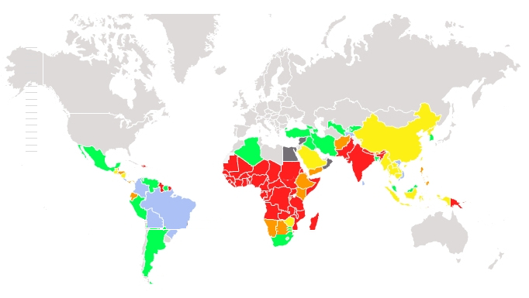
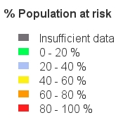
Malaria is more common in the Southern Hemisphere and in developing countries
Copyright © Global Malaria Mapper. All rights reserved.
Which populations are at the highest risk of catching malaria? Why do you think some countries, like the US, are not at risk?
Notes:
This map is included under fair-use guidelines of Title 17, US Code. Copyright © Global Malaria Mapper. Map available online at http://www.worldmalariareport.org/node/57#.

Slide 20
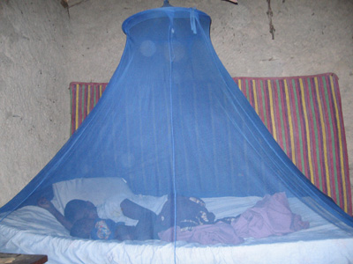
Global action to fight malaria has reduced deaths by more than one third
Insecticide-treated bed nets are called ITNs. They are a form of personal protection that have been shown to reduce malaria illness and death due to malaria.
A mother and her child sleep in a mosquito net in Tanzania.
For ITNs to be effective, people need to be taught how to use them properly. What do you think are some of the other challenges of making ITNs an effective preventive measure?
Notes:
Image retrieved from http://commons.wikimedia.org/wiki/File:Malaria_prevention-Insecticide_treated_bed_net-PMI.jpg on August 30, 2013. From President’s Malaria Initiative (PMI).
Data from CDC, “Insecticide-Treated Bed Nets,” http://www.cdc.gov/malaria/malaria_worldwide/reduction/itn.html.

Slide 21
Progress is being made to fight communicable diseases
In 2011, 56% of pregnant women living with HIV in low- and middle-income countries received effective drugs to avoid transmission to their children, up from 48% in 2010.
The WHO continues to develop new health interventions, such as the rotavirus immunization, to fight diarrheal disease.
The TB death rate has dropped 41% since 1990.
Malaria mortality rates have fallen more than 25% globally since 2000.
Notes:
Data from WHO, “HIV/AIDS” (http://www.who.int/mediacentre/factsheets/fs360/en/); WHO, “Fact Sheet 94: “Malaria” (http://www.who.int/mediacentre/factsheets/fs094/en/); and WHO, “Fact File: 10 Facts about Tuberculosis” (http://www.who.int/features/factfiles/tb_facts/en/index4.html).

