Slide 1
Imperialism- Part 2

Slide 2
Examples
Africa dominated by Europe
Ottoman empire dominated by Europe
Britain imperialized India
European control of Southeast Asia
US imperialism of the Pacific Islands (Philippines and Hawaii)
European control of China
US economic control of Latin America and Mexico

Slide 3
Latin America
Britain and US became main trading partners with Latin America.
Latin America exported beef, fruits and vegetables.
They imported manufactured goods and did not industrialize.
US helped Latin America become independent of Spain.
Unfortunately, US then put in own military government and controlled Puerto Rico, Guam and the Philippines.
These became US territories.

Slide 4
Philippines
1898- Spanish-American War
US acquired the Philippine Islands, Puerto Rico, and Guam
Had helped free Philippines from Spain and then took control themselves.
Filipino nationalists fought the US but eventually lost.
US built up the Philippine infrastructure, but also traded food crops for cash crops.

Slide 5
Hawaii
US had long history of interest in Hawaii.
Port on the way to China and East India
Site of American sugar-cane plantations
1890 McKinley Tariff Act eliminated tariffs on sugar and reduced profit.
Plantation owners wanted to annex Hawaii so they could sell sugar for more, increasing profits.

Slide 6
Queen Liliuokalai attempted to restore political power to Hawaii that was currently in the hands of the American sugar planters.
American businessmen overthrew her and named Sanford Dole as the president of the Republic of Hawaii.
In 1898, Hawaii was annexed.

Slide 7
China resisted
China had a history of looking down on foreigners.
In 1793, the Qing emperor and England’s King George III engaged in an exchange of sorts.
England wanted full trade.
China was self-sufficient.
Crops: rice, maize, sweet potatoes and peanuts
Mining industry: salt, tin, silver and iron
Manufacturing industry
Positive trade balance

Slide 8
Britain smuggled in opium to addict the Chinese.
By 1835, 12 million were addicted.
1939- Opium War
China tried to stop British from bringing in Opium.
Britain defeated China.
Treaty of Nanjing gave Hong Kong to Britain.
Later fighting internally to regain control, but China was no match for Britain and France.

Slide 9
Open Door Policy
US feared other countries gaining footing in China at US expense.
Opened trade to all countries without colonization.
Great for the other countries but did nothing to help China.

Slide 10
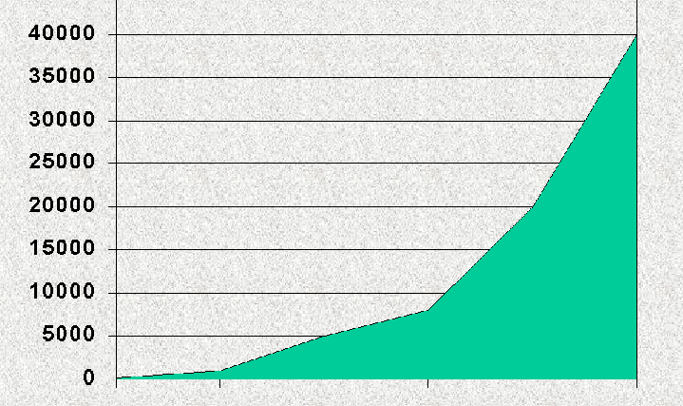
Chests of Opium brought into China

Slide 11
Japan
Long history of isolationism.
Traded with China and Dutch.
Had diplomatic contact with Korea.
US tried to bully their way into trade with Japan in 1853.
In 1854, Treaty of Kanagawa opened two Japanese ports to US ships.

Slide 12
Japan then tried to force Korea into trade with them in 1876.
1885, China and Japan agreed to leave Korea alone.
1894, China helped Korea to put down rebellions. Japan came in to fight out of fear the two countries would join economically at Japan’s expense.
Japan had more power and ended up with colonial holdings in Korea.

Slide 13
Russia and Japan fought over Manchuria.
Japan offered to give Russia Manchuria if they would stay out of Korea.
Russia refused and the Russo-Japanese War began.
Japan won.
US helped negotiate the peace treaty which gave Japan the land holdings.

Slide 14
Panama Canal
US wanted more control of trade.
Offered money to Panama for right to build a canal to join Atlantic and Pacific Ocean without going around the tip of S. America.
US helped Panama revolt against Columbia in exchange for building rights.
Completed in 1914.

Slide 15
Mexico
Controlled by Spain, then France (Napoleon), then control back to Mexico.
US wanted to extend its territory west into land owned by Mexico.
US did get Texas.

