Slide 1
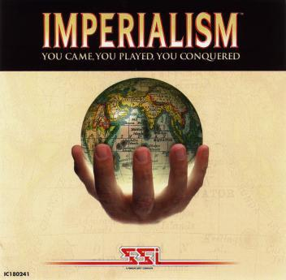

Slide 2
Imperialism: The policy by which a stronger nation attempts to create an empire by dominating weaker nations economically, politically, culturally, and/or militarily.

Slide 3
What is imperialism?
The seizure (takeover) of a country or territory by a stronger country
Europeans want to control all aspects of their colonies
  Politics
  Society
  Economy
  Culture and customs

Slide 4
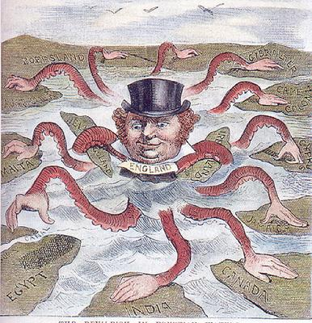
Causes of Imperialism:
Agricultural Revolution
Industrial Revolution
Nationalism
4) Social Darwinism

Slide 5
Causes of Imperialism:
1) Agricultural Revolution
a) more food = more people
b) more people need more space to live
2) Industrial Revolution
a) need more and more natural resources to use in factories
b) need new supplies of labor to keep wages low
c) need to find new markets of people to buy products
3) Nationalism
a) countries prove their greatness by acquiring colonies
b) countries compete with each other to get more colonies
4) Social Darwinism
a) strong countries should rule over weak countries
b) spread Western Civilization

Slide 6
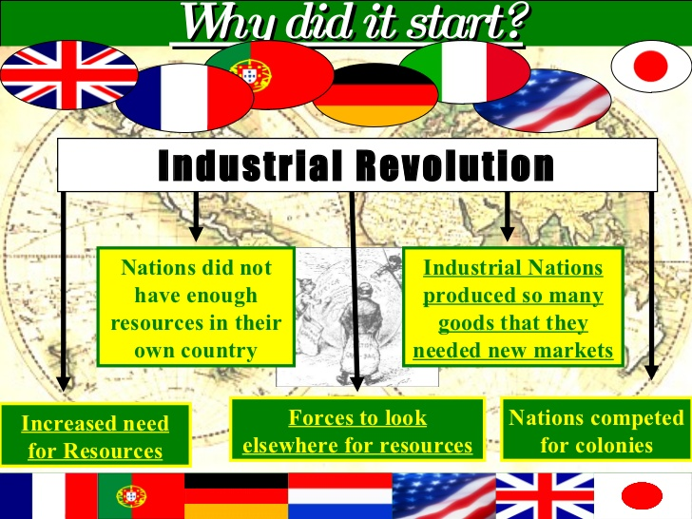

Slide 7


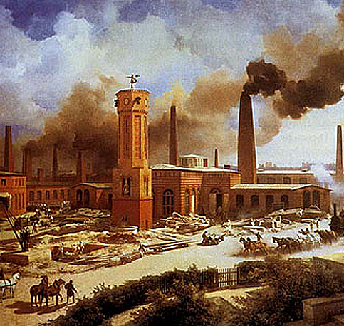
Causes of Imperialism
Industrialization
Industrialists needed more raw materials to supply their factories, and foreign markets where they could sell their finished products.
Industrialists also needed places to invest their profits, which would multiply their riches.

Slide 8
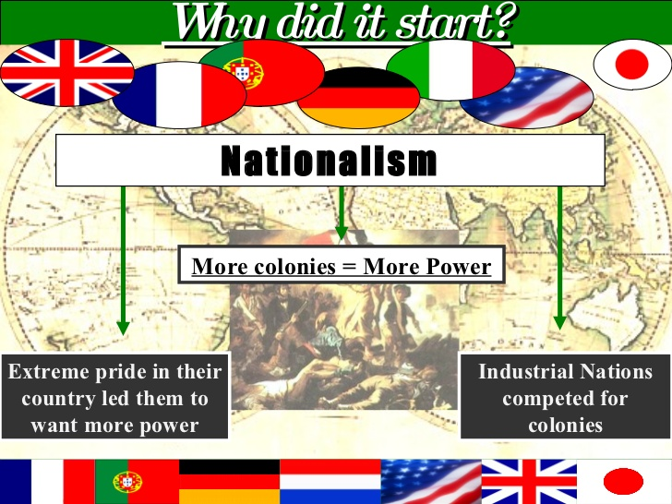

Slide 9
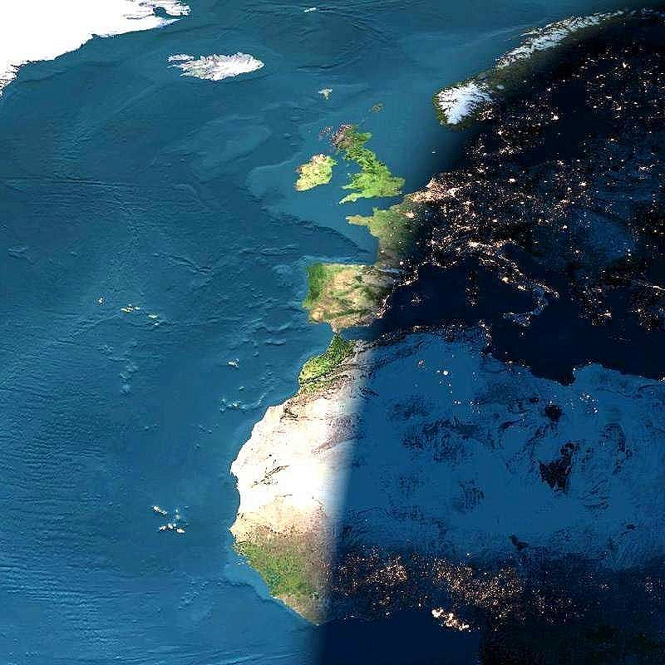
Causes of Imperialism
Nationalism
National pride led many nations to strive for a world empire.
Most Europeans felt their nationality was superior to that of the Africans and Asians.
The English boasted, “The sun never sets on the British Empire.”
Kaiser Wilhelm wanted Germany to have its “place in the sun.”

Slide 10
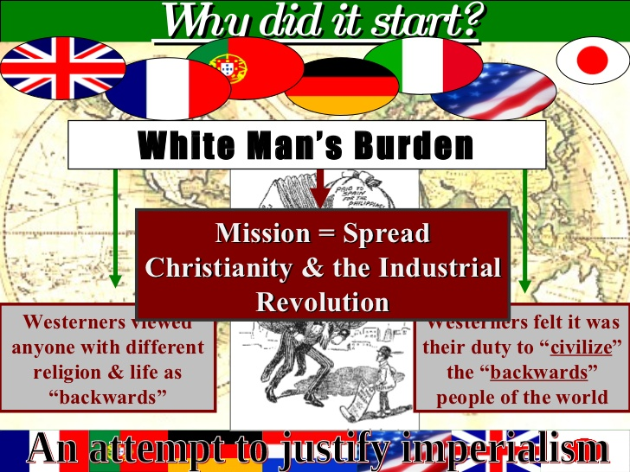

Slide 11
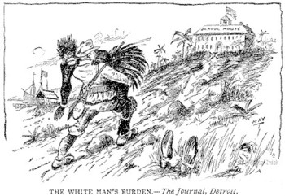
The White Man’s Burden was the idea that Europeans had to conquer the rest of the world, to spread the benefits of Western Civilization.
This was supposed to help them…

Slide 12
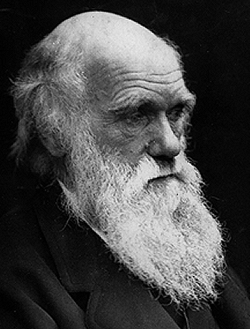
Causes of Imperialism
Social Darwinism
Darwin’s theories of natural selection and survival of the fittest were used by many to support imperialism.
Many Europeans believed that it was natural and right for strong nations to conquer weaker ones.
Defeating a weaker race, according to Social Darwinism, could only strengthen the human race.
Charles Darwin

Slide 13
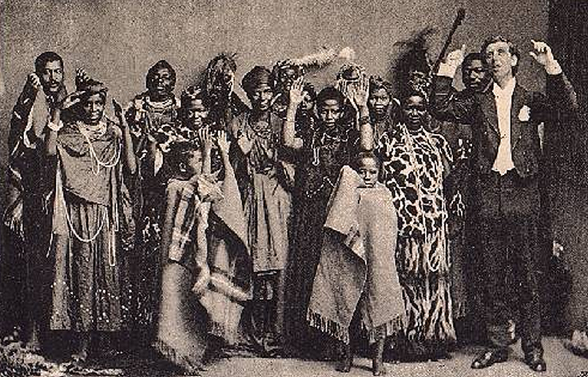
Causes of Imperialism
Religion
Christian missionaries wanted to help Africans and Asians, and worked to carry the “White Man’s Burden,” which included:
1. Christianizing the natives in order to civilize them.
2. Bringing natives the technological benefits of western civilization.
3. Teaching Africans to read and write.

Slide 14
Economic Motives
Industrialized nations sought:
* raw materials
* natural resources
* a cheap labor supply
* new marketplaces for manufactured goods

Slide 15
Driven by technological advances
The steam engine
Better transportation
Increased exploration is possible
Communication improved

Slide 16
Types of Imperialism
Methods of Management
  Direct Control
    Paternalism – Europeans provide for local people but grant no rights
    Assimilation – adaptation of local people to ruling culture
  Indirect Control
    Limited self-rule for local governments
    Legislative body includes colonial & local officials

Slide 17
Forms of Imperialism
Types of Management
INDIRECT CONTROL | DIRECT CONTROL
Local government officials were used Limited self-rule GOAL: to develop future leaders Government institutions are based on European styles but may have local rules | Foreign officials brought in to rule No self-rule GOAL: assimilation (the process in which a minority group adopts the customs of the prevailing culture) Government institutions based only on European styles Paternalism: people governed in a fatherly way where their needs are provided for but they’re not given rights

Slide 18
Types of Imperialism
Forms of Control
  Colony
    Governed by a foreign power
  Protectorate
    Governs itself, but under outside control
  Sphere of Influence
    Outside power controls investments & trading
  Economic Imperialism
    Private business interests assert control

Slide 19
Forms of Imperial Control
Colony
  Governed internally by a foreign power
Protectorate
  Own internal government but under control of an outside power
Sphere of Influence
  Outside power claims exclusive investment or trading rights

Slide 20
The Scramble for Africa
Africa Before European Dominion
  Divided into hundreds of ethnic groups
  Followed traditional beliefs, Islam or Christianity
  Nations ranged from large empires to independent villages
  Africans controlled their own trade networks
  Europeans only had contact on African coasts

Slide 21
  Factors Promoting Imperialism in Africa
    European technological superiority
    Europeans had means to control
    New medicines prevent diseases

Slide 22
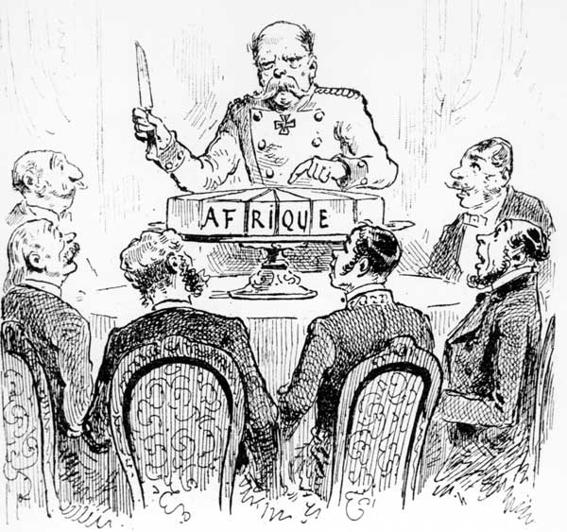
The Division of Africa
The Berlin Conference (1884)
  Europeans leaders divide Africa
  No African ruler invited
  Little or no thought about the complex differences in ethnic groups
  By 1914 – Only independent nations
    Liberia
    Ethiopia

Slide 23
Imperialism in Africa
Berlin Conference, 1884-1885
  European nations met to lay down rules for the division of Africa
Any European nation could claim land in Africa by telling the others and showing they could control the area
Europeans paid no attention to the ethnic and linguistic divisions in Africa when dividing it amongst themselves
No African leaders attended this meeting… Why might that be unfair??

Slide 24
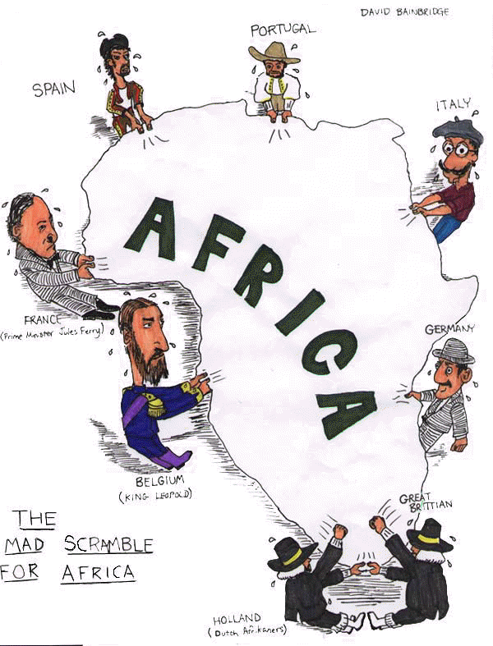
According to this cartoon, which European countries were fighting for a position in Africa?
How did the Berlin Conference lead to the situation shown in the cartoon?

Slide 25
African Resistance
Africans Confront Imperialism
  Broad resistance, but Europeans have superior weapons
Unsuccessful Movements
  Algeria fights the French for 50 years
  German East Africa resistance results in 75,000 deaths
Successful Movements
  Ethiopia under Emperor Menelik II
  Plays Europeans against each other
  Stockpiles modern weapons
  Defeats Italy and remains independent

Slide 26
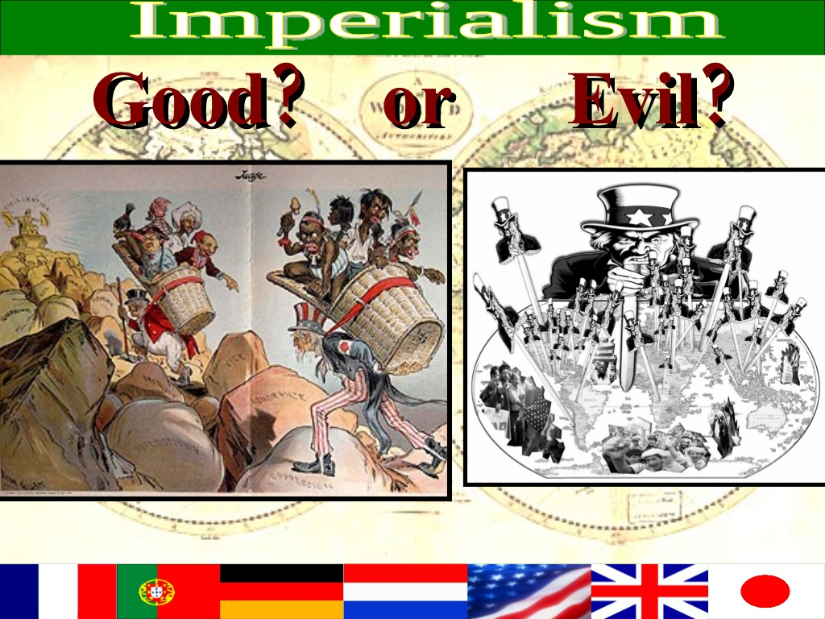

Slide 27
Positive Impacts of Colonial Rule
Reduced local warfare
Improved sanitation, hospitals & education
African products popular in European Market
Improved infrastructure
  Railroads,dams, telephones & telegraph lines

Slide 28
Negative impacts of Colonial Rule
Lost land & independence
Death caused by new disease & resistance
Change to cash crops resulted in famine
Breakdown of traditional culture
European establishment of boundaries (Problem today)

Slide 29
Impact of Imperialism in Africa
POSITIVE
  Local warfare reduced
  Improved sanitation
  Hospitals led to increased lifespan
  Schools led to increased literacy
  Economic growth
NEGATIVE
  Loss of land and independence
  Men forced to work in European owned mines and on European owned farms
  Contempt for traditional culture and admiration of European culture = identity problems
  Dividing up of Africa = artificial boundaries divided kinship groups and united rivals

Slide 30
Legacy of Imperialism
Negative Effects
  Africans lose land and independence
  Many lives are lost
  Traditional cultures breakdown
  Division of Africa creates problems that continue today
Positive Effects
  Reduces local fighting
  Sanitation improves
  Hospitals and schools created
  Technology brings economic growth

