Slide 1
The Atlantic World

Slide 2
Columbus
Who did Columbus sail for?
What was his “mission?”
Was he successful?
Why did he call the people in the Americas Indians?

Slide 3
In 1492, Columbus sailed the ocean blue
To find land around the Bahamas instead of Asia as planned
Claimed land for Spain
What impact did this have on the native people?

Slide 5
Others followed Columbus’s lead through the 16th century
Portuguese claimed Brazil
Americo Vespucci sailed the coast of South America
Magellan sailed around the world
Spain conquered the Aztecs and Incas of South America and Mexico
Notes:
Realized it was a continent previously unknown to the Europeans
Named it America
A new map was drawn

Slide 6
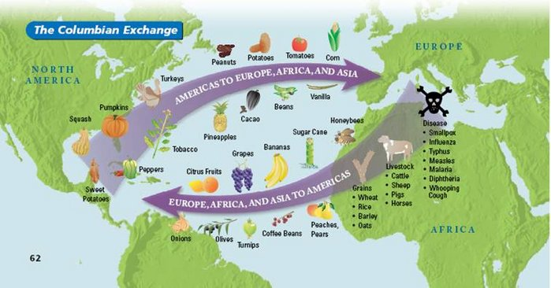
Columbian Exchange

Slide 7
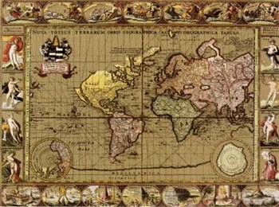

Slide 8
What peoples were already in the Americas?
Were they civilizations?
Tenochtitlan was the Aztec capital
Current Mexico City
Traveled along canals
Had toilets in the homes of the rich
People cleaned the streets
Notes:
Aztec and Inca civilizations
Very well developed

Slide 9
Aztecs
Notes:
city

Slide 10
Notes:
Busy market

Slide 11
Ha
Notes:
Had a developed religion that included human sacrifice.
Might that have made it easier for Europeans to justify conquering them?

Slide 12
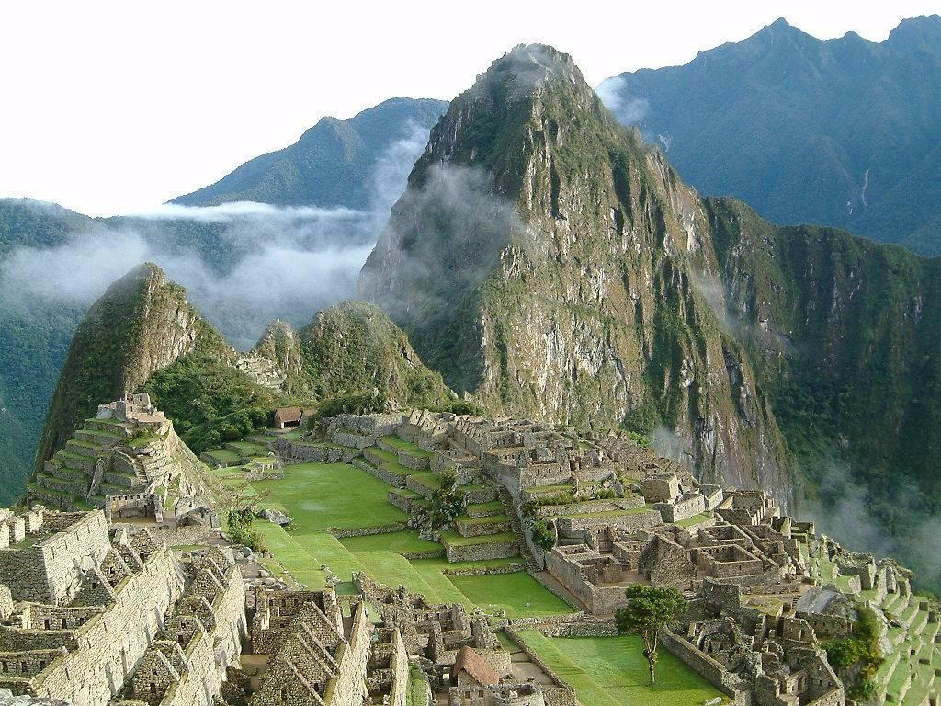
Incas
Notes:
Had a road system
A government
City of Machu Picchu, unknown to all but locals until 1911
Neslled into the top of a mountain- had houses, temples and terraces

Slide 13
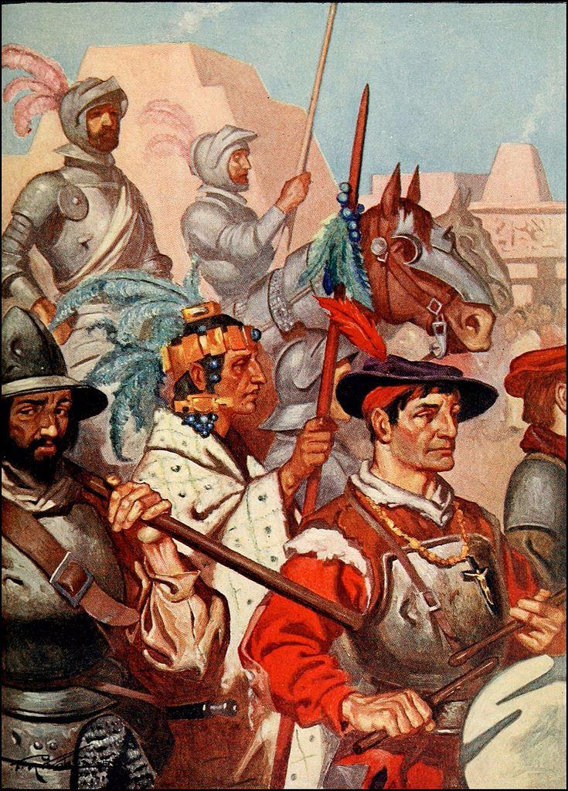
Spanish brought an end to them
Conquistadors conquered
Opened new trade routes
Colonized for Spain and Portugal
Forced Christianity

Slide 14
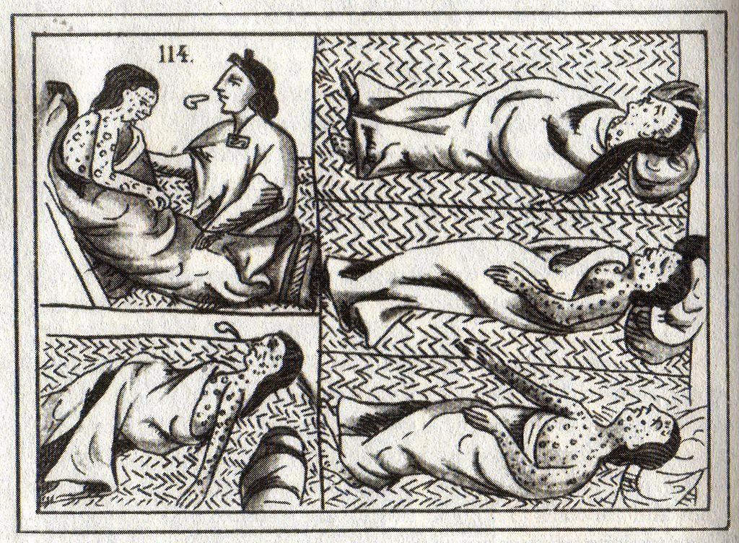
Notes:
Europeans brought disease

Slide 15
Europeans come to North America- 17th Century
French- Canada and Midwest
English- Jamestown, Virginia- first permanent settlement and Plymouth- Puritan pilgrims
Dutch- became New York

Slide 16
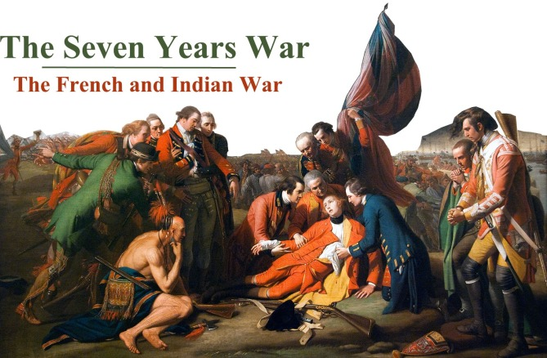
Clash…..
French and Indian War- 1754
“Indians” helped the French
Sever Years’ War- same war but in Europe
Notes:
clash over Ohio Valley between French and English (English wanted to go west and French wanted to go south- bumped into each other
1763- France lost all of land in North America to England.
French were more interested in beaver trade- English more into control
French and Indian War names the English enemies

Slide 17
Slavery
When “Indians” died, turned to African slaves
Workers needed for plantations in North and South America
Tobacco, sugar, coffee
African rules sold their own people
Established the Triangular Trade
Middle Passage- slave portion of the triangle

Slide 18
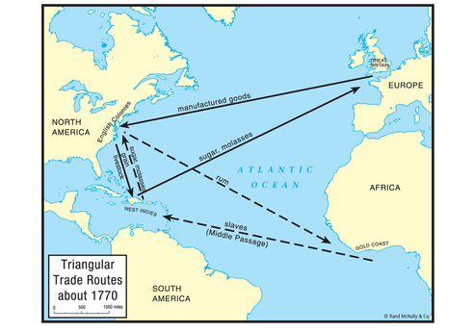
Caribbean Islands
Notes:
Consequences of slavery: loss of culture, harsh life
Did maintain songs and beliefs, but struggled to hold traditions
Mixed races today, influenced by usic

Slide 19
Capitalism hits the Americas
Economic revolution
New business practices
Capitalism: private ownership and right to profit
Joint stock companies pooled investment and shared profits

Slide 20
Mercantilism
Europeans got raw materials from colonies
Made product and sold it back to colonies
Goal was more gold and silver and a favorable trade balance
As colonies grew, they became a strong market for goods

