Slide 1
The Causes of Revolutions
Enlightenment and
Absolutism

Slide 2
Enlightenment
Heavily influenced by :
Locke- social contract theory
Right of citizens to revolt
Life, liberty and property- natural rights
Voltaire- freedom of religion and separation of church and state
Rousseau- government by the people
Protection of all through democracy
Hobbes- absolute sovereign to protect people equally

Slide 3
A European intellectual movement of the late 17th and 18th centuries emphasizing reason and individualism rather than tradition.
New and better ways of doing things
New ways of thinking

Slide 4
What are some enlightenment ideas?
Why would this make people look towards change?

Slide 5
Exploration and Colonization
Europe’s exploration and colonization of far-off lands brought new experiences, ideas and challenges. There was a dramatic explosion in intellectual activity.
To continue exploration and control colonization, it often became necessary to have a stronger centralized government.

Slide 6
Absolute Monarchs
Ruled by divine right
Ruled absolutely
Government was centralized and crossed all parts of life
No checks and balances

Slide 7
This was an unpopular way to rule.
Initially, helped secure the country
Economics improved
Later, led to unrest.
What kind of government would Locke suggest? How about Rousseau?

Slide 8
Economic Problems
Absolute monarchs spent without and checks and balances
All heavily taxed the people
Borrowed to meet expenses
Fought wars that were very expensive
King Phillip II of Spain
Louis XIV bankrupted France
Built palaces
Versailles: King Louis XIV of France

Slide 9
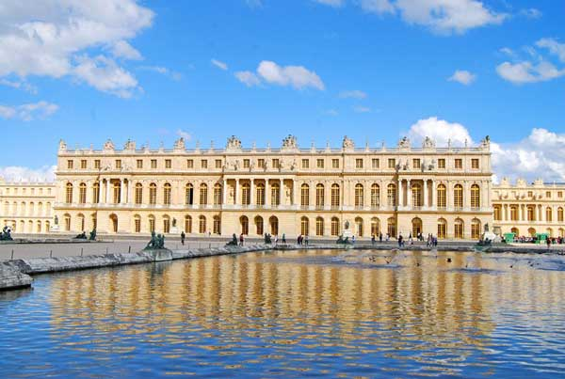

Slide 10
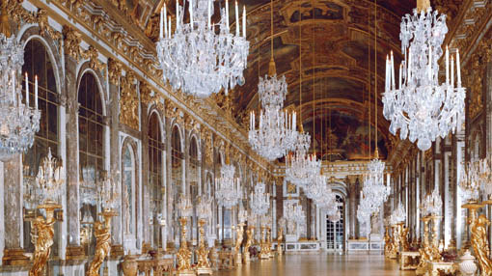

Slide 11
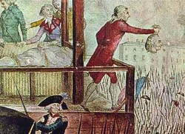
Social Injustices
People were not treated fairly/equally
King Phillip II of Spain- Spanish Inquisition against all Protestants
Peter the Great of Russia- forced all citizens into military or government projects, dependent on class. Also, tortured and killed any who challenged him.

Slide 12
Religious Intolerance
King Phillip II of Spain- Spanish Inquisition against all Protestants

Slide 13
Nationalism
People developed a pride in there country and its people.
Desire rose to be independent.

Slide 14
